Slide 1
Oracle 21c New Features and Enhancements of Data Pump & TTS
Christian Gohmann HrOUG Conference, 13. October 2021

Slide 2
HALLO, GRÜEZI, HI!
Christian Gohmann
Principal Consultant, Instructor and Tool Owner of db*BACKUP
Working with Oracle since 2006
Focused on High Availability Solutions, Migration Projects, Backup & Recovery and Cloud Technologies
Oracle ACE

Slide 3
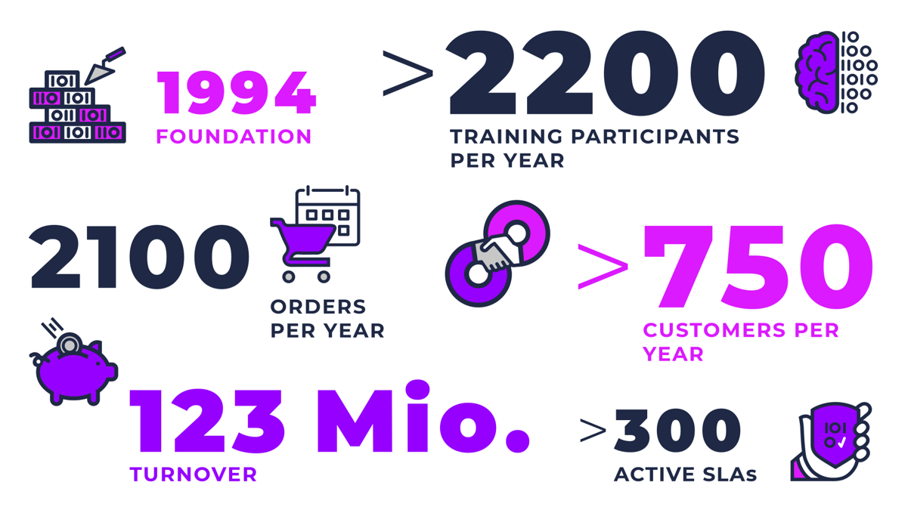

Slide 4
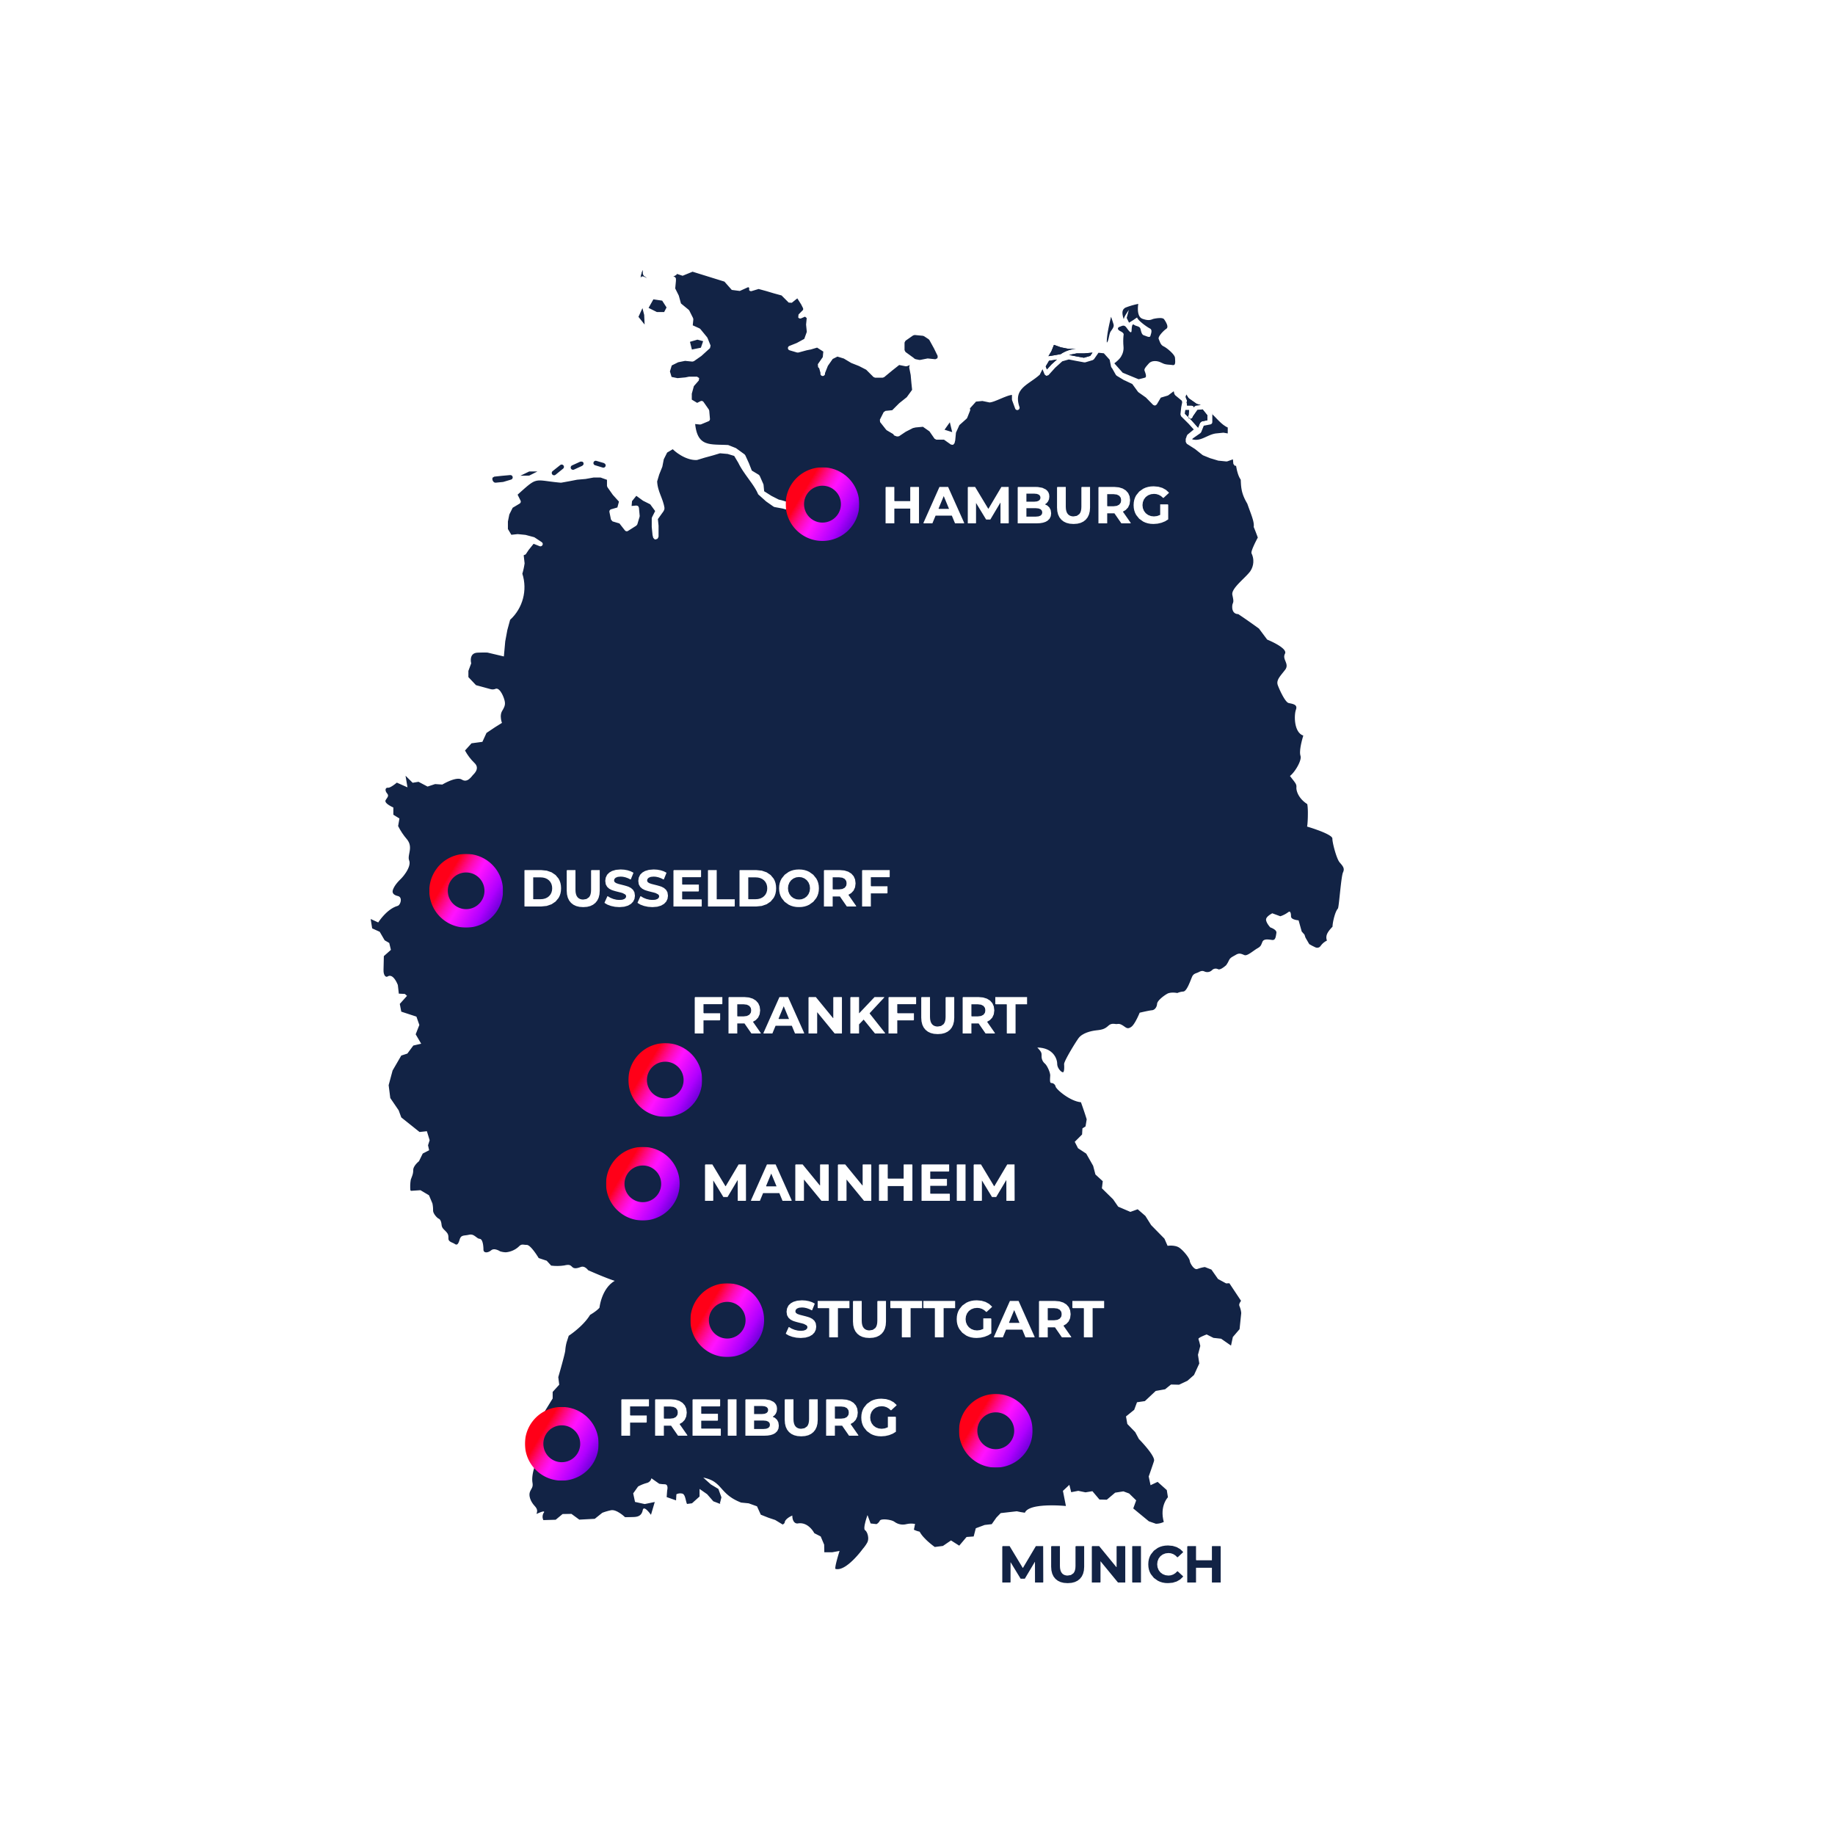
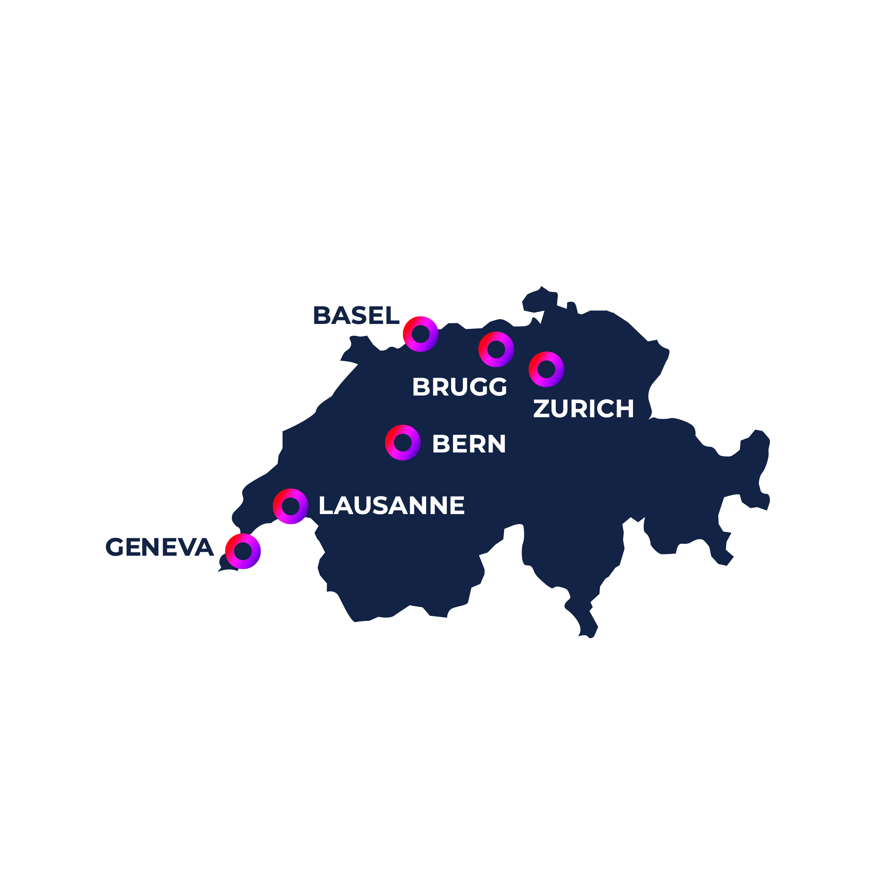
OUR Workspaces
GERMANY
AUSTRIA
ROMANIA
SWITZERLAND

Slide 5
Agenda
Introduction
Data Pump
Transportable Tablespaces (TTS)

Slide 6
Introduction

Slide 7
Oracle 21c
Available since 8th of December 2020 as Cloud-first release
Autonomous Database Service (including Always Free Tier (not in all regions))
Database Service
Virtual Machine (RAC, Single Instance)
Bare Metal (Single Instance)
On-premises version for Linux was released 13. August 2021
Including a new version of Oracle Database Express Edition (XE)
Other platforms will be released later
See MOS note Release Schedule of Current Database Releases (Doc ID 742060.1)
Innovation release with Premier Support until 30. June 2023 (no Extended Support)
Oracle 21c Live Labs Workshops
https://apexapps.oracle.com/pls/apex/f?p=133:100:109140367598541::::SEARCH:21c
Use your 30-days Oracle Cloud free trial to get hands on experiences with Oracle 21c (RAC).

Slide 8
Always-free Autonomous Database 1/2
Oracle 21c is available in the regions Ashburn (IAD), Phoenix (PHX), Frankfurt (FRA) and London (LHR)
Can only be created in the home region of the user
Navigate to Oracle Database > Autonomous Databases
Direct link: https://cloud.oracle.com/db/adb
Current workload types supported for always-free

Slide 9
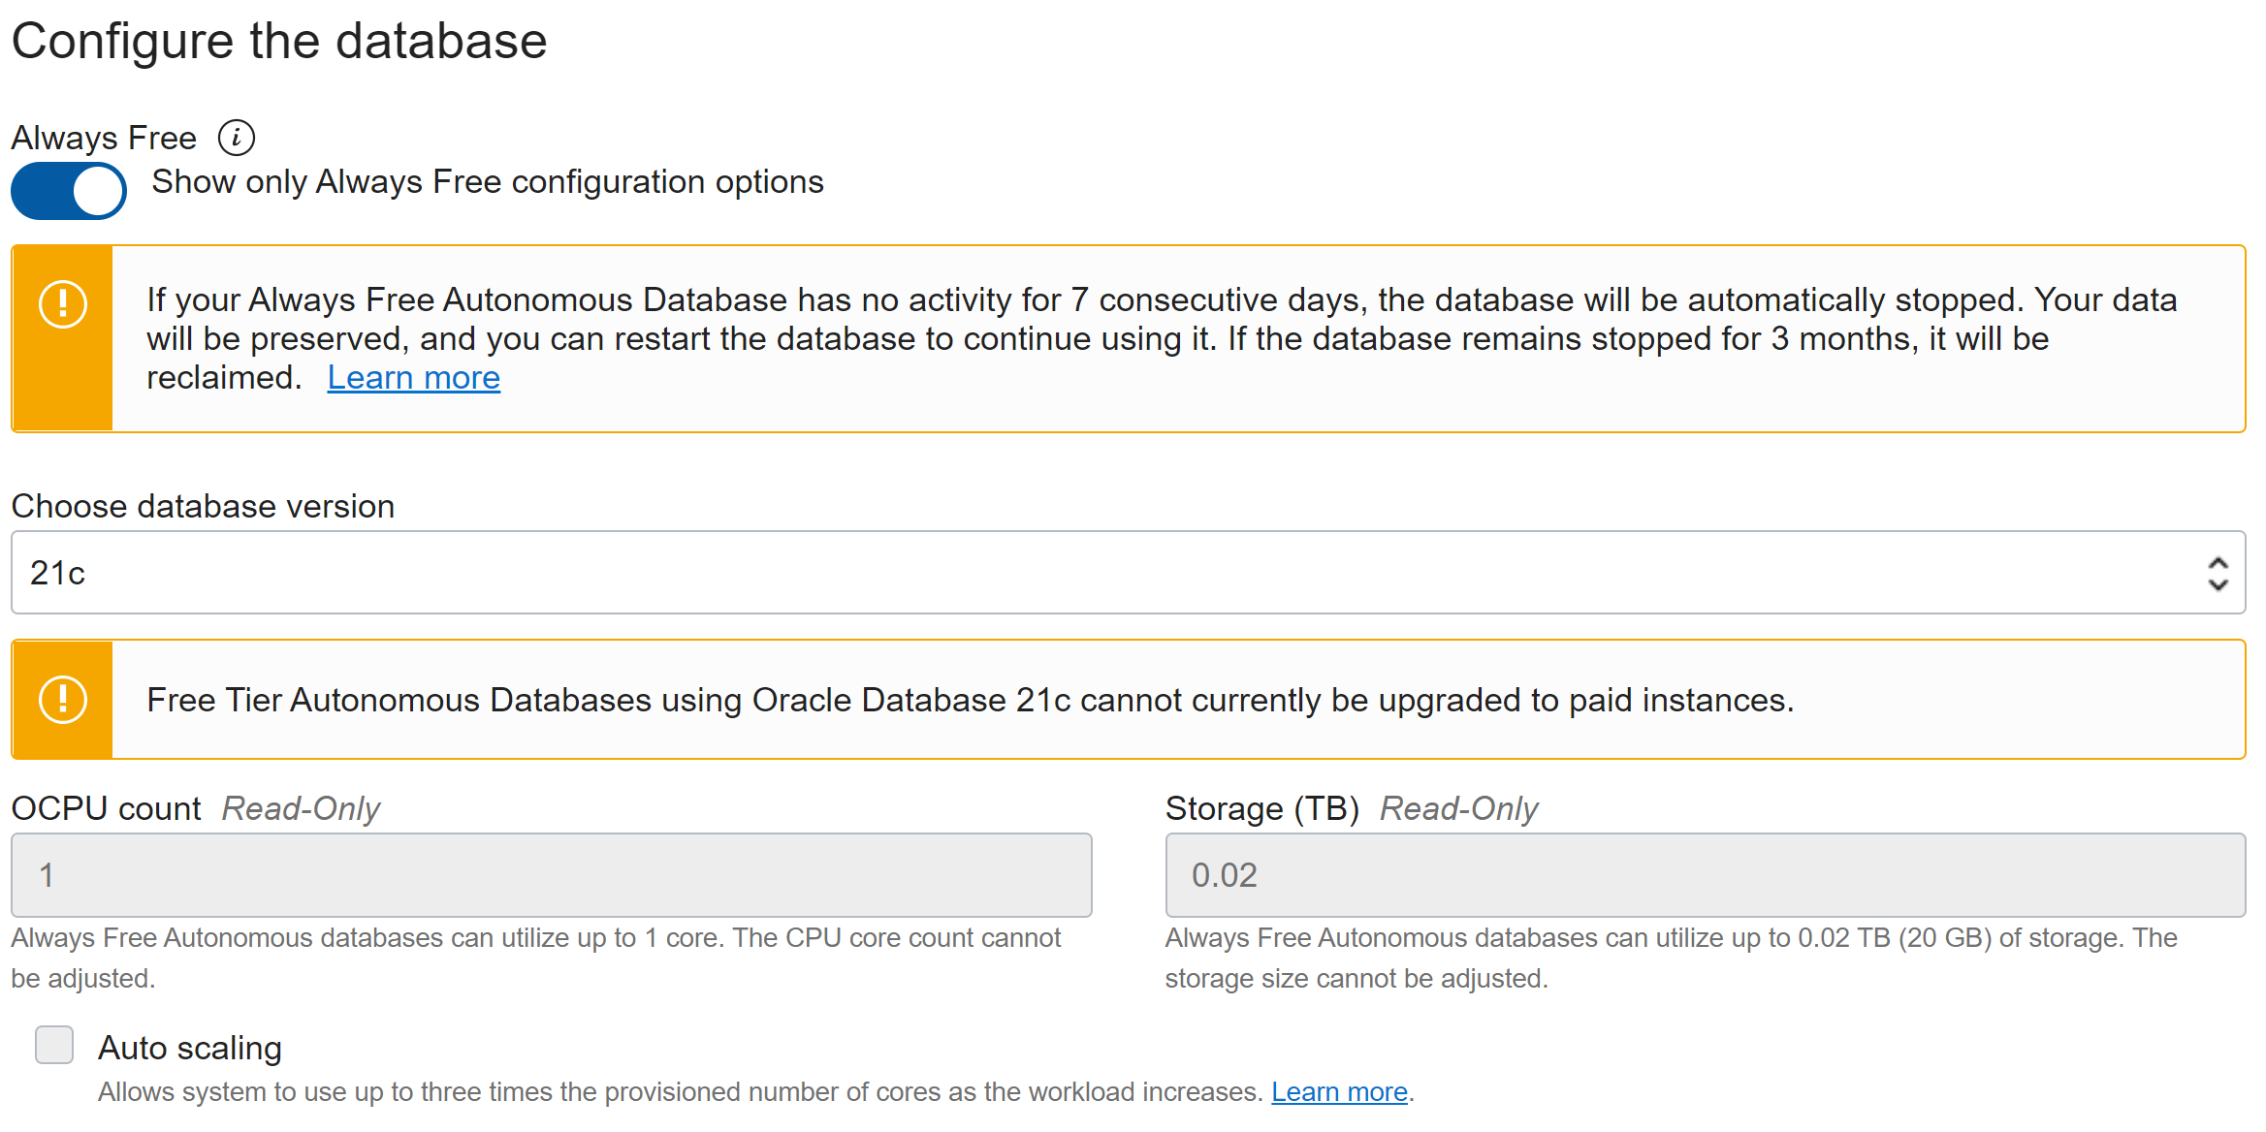
Always-free Autonomous Database 2/2

Slide 10
Data Pump

Slide 11
Simultaneous use of EXCLUDE and INCLUDE
Before 21c, the parameters EXCLUDE and INCLUDE were mutually exclusive
This restriction is lifted with 21c
When both parameters are used, the INCLUDE parameter is evaluated first
UDE-00011: parameter include is incompatible with parameter exclude
$> vi expdp_tables.par
...
SCHEMAS=HR,SH
INCLUDE=TABLE
EXCLUDE=TABLE:"IN ('COSTS', 'SALES')"
$> expdp parfile=expdp_tables.par
$> vi impdp_tables.par
...
SCHEMAS=HR
INCLUDE=TABLE
EXCLUDE=TABLE:"IN ('JOB_HISTORY')"
EXCLUDE=INDEX,STATISTICS
$> impdp parfile=impdp_tables.par

Slide 12
Checksum Support 1/3
Oracle 21c supports the generation of checksums for the dump files using CHECKSUM parameter
Can be used to confirm validity of the dump file(s)
Data Pump writes control information into the header block of each dump file
Extended by checksums for the remaining blocks
Use CHECKSUM_ALGORITHM to choose checksum algorithm
CRC32
SHA256 (default)
SHA384
SHA512
Generating checksums for dump file set
No new item codes in DBMS_DATAPUMP.GET_DUMPFILE_INFO for the checksum support.
Notes:
ORA-39002: invalid operation
ORA-39050: parameter CHECKSUM=NO is incompatible with parameter CHECKSUM_ALGORITHM

Slide 13
Checksum Support 2/3
Verify a dump file using impdp and VERIFY_ONLY parameter
ORA-39412 is raised when an invalid checksum is detected
$> impdp ... VERIFY_ONLY=YES
…
Verifying dump file checksums
Master table "SYSTEM"."SYS_IMPORT_SCHEMA_01" successfully loaded/unloaded
dump file set is complete
verified checksum for dump file "/backup/dumps/expdp_hr_sh.dmp"
dump file set is consistent
Job "SYSTEM"."SYS_IMPORT_SCHEMA_01" successfully completed at Sun Apr 18 16:20:58 2021 elapsed 0 00:00:03
ORA-39002: invalid operation
ORA-39412: file checksum error in dump file "/backup/dumps/expdp_hr_sh.dmp"
Notes:
ORA-39002: invalid operation
ORA-39050: parameter CHECKSUM=NO is incompatible with parameter CHECKSUM_ALGORITHM

Slide 14
Checksum Support 3/3
Use parameter VERIFY_CHECKSUM during import to validate the dump files as first step
If turned off, a warning is written to the screen/log
$> impdp ... VERIFY_CHECKSUM=YES
…
Verifying dump file checksums
Master table "SYSTEM"."SYS_IMPORT_FULL_01" successfully loaded/unloaded
Starting "SYSTEM"."SYS_IMPORT_FULL_01": system/********@C21SFE1PDB1 parfile=impdp_21c_demo_checksum.par
Processing object type TABLE_EXPORT/TABLE/TABLE
Warning: dump file checksum verification is disabled
No warning/error is raised, when the dump file does not include checksums.

Slide 15
Object Storage Integration 1/5
Data Pump can access the Object Store during export and import operations
Parameter DUMPFILE now supports a Uniform Resource Identifier (URI)
Credential for the target bucket is provided by the parameter CREDENTIAL
Use the PL/SQL package DBMS_CLOUD to create the required credential
MOS note How To Setup And Use DBMS_CLOUD Package (Doc ID 2748362.1)
DUMPFILE=https://objectstorage.<Region>.oraclecloud.com/n/<Namespace>/b/<Bucket>/o/mydump_%u.dmp
DBMS_CLOUD is pre-installed, configured and maintained in Oracle Autonomous Database
Manual installation steps
The following steps are required to manually install and enable DBMS_CLOUD. This package is supported in Oracle Database 19c beginning with 19.9 and in Oracle Database 21c beginning with 21.3.
Only the CDB architecture is supported by DBMS_CLOUD.

Slide 16
Object Storage Integration 2/5
Internally, the Object Store ODM Library is used to access the Object Store.
Per default, the library is disabled
Trying to access the Object Store with Data Pump fails
A relink of the Oracle Home is required – stop all running processes before
ORA-39001: invalid argument value
ORA-39000: bad dump file specification
ORA-31641: unable to create dump file
"https://swiftobjectstorage.region.oraclecloud.com/v1/namespace/bucketname/ORACLE_test01.dmp"
ORA-27040: file create error, unable to create file
Linux-x86_64 Error: 2: No such file or directory
Additional information: 1
$> cd $ORACLE_HOME/rdbms/lib
$> make -f ins_rdbms.mk opc_on

Slide 17
Object Storage Integration 3/5
Create credential and test access to the target bucket
SQL> BEGIN
DBMS_CLOUD.CREATE_CREDENTIAL(
credential_name => 'CLOUD_ACCESS',
username => 'christian.gohmann@trivadis.com',
password => '[Au_L8F0DRb_}lXmcM-G'
);
END;
/
SQL> SELECT COUNT(*) AS "OBJECT_COUNT"
FROM DBMS_CLOUD.LIST_OBJECTS('CLOUD_ACCESS','https://objectstorage.eu-frankfurt-1.oraclecloud.com/n/kwq12gukapmy/b/datapump-dumps/o/');
OBJECT_COUNT
------------
1
Auth Token
Error ORA-20404 is raised, when the URI is invalid, or the user is not authorized to access the bucket.
Notes:
ERROR at line 1:
ORA-20404: Object not found - https://objectstorage.eu-zurich-1.oraclecloud.com/n/kwq12gukapmy/b/datapump-dumps/o/
ORA-06512: at "C##CLOUD$SERVICE.DBMS_CLOUD", line 964
ORA-06512: at "C##CLOUD$SERVICE.DBMS_CLOUD", line 2648
ORA-06512: at line 1

Slide 18
Object Storage Integration 4/5
Perform export/import using command-line tools
$> vi expdp.par
USERID=system/manager
DIRECTORY=DATA_PUMP_DIR
DUMPFILE=https://objectstorage.eu-frankfurt-1.oraclecloud.com/n/cre01gulanmy/b/datapump-dumps/o/test_%U.dmp
CREDENTIAL=CLOUD_ACCESS
SCHEMAS=SCOTT
$> expdp parfile=expdp.par
…
Master table "ADMIN"."SYS_EXPORT_SCHEMA_01" successfully loaded/unloaded
******************************************************************************
Dump file set for ADMIN.SYS_EXPORT_SCHEMA_01 is:
https://swiftobjectstorage.eu-frankfurt-1.oraclecloud.com/v1/cre01gulanmy/datapump-dumps/test_01.dmp
Job "ADMIN"."SYS_EXPORT_SCHEMA_01" successfully completed at Wed Apr 7 19:14:01 2021 elapsed 0 00:02:10
Parameter DATA_PUMP_DIR is still required for the log file.
Notes:
expdp admin@db202102261636_tp directory=data_pump_dir credential=CLOUD_CRED dumpfile=https://objectstorage.eu-frankfurt-1.oraclecloud.com/n/zrq07gukammy/b/datapump-dumps/o/test_%u.dmp
Export: Release 19.0.0.0.0 - Production on Wed Apr 7 19:11:30 2021
Version 19.10.0.0.0
Copyright (c) 1982, 2021, Oracle and/or its affiliates. All rights reserved.
Password:
Connected to: Oracle Database 21c Enterprise Edition Release 21.0.0.0.0 - Production
Starting "ADMIN"."SYS_EXPORT_SCHEMA_01": admin/********@db202102261636_tp directory=data_pump_dir credential=CLOUD_CRED dumpfile=https://objectstorage.eu-frankfurt-1.oraclecloud.com/n/zrq07gukammy/b/datapump-dumps/o/test_%u.dmp
Processing object type SCHEMA_EXPORT/TABLE/TABLE_DATA
Processing object type SCHEMA_EXPORT/TABLE/INDEX/STATISTICS/INDEX_STATISTICS
Processing object type SCHEMA_EXPORT/TABLE/STATISTICS/TABLE_STATISTICS
Processing object type SCHEMA_EXPORT/STATISTICS/MARKER
Processing object type SCHEMA_EXPORT/USER
Processing object type SCHEMA_EXPORT/SYSTEM_GRANT
Processing object type SCHEMA_EXPORT/ORACLE_OBJECT_GRANT/OBJECT_GRANT
Processing object type SCHEMA_EXPORT/ROLE_GRANT
Processing object type SCHEMA_EXPORT/DEFAULT_ROLE
Processing object type SCHEMA_EXPORT/TABLESPACE_QUOTA
Processing object type SCHEMA_EXPORT/PASSWORD_HISTORY
Processing object type SCHEMA_EXPORT/PRE_SCHEMA/PROCACT_SCHEMA
Processing object type SCHEMA_EXPORT/TABLE/TABLE
Processing object type SCHEMA_EXPORT/TABLE/COMMENT
Processing object type SCHEMA_EXPORT/TABLE/INDEX/INDEX
Processing object type SCHEMA_EXPORT/POST_SCHEMA/PROCOBJ
Processing object type SCHEMA_EXPORT/POST_SCHEMA/PROCACT_SCHEMA
. . exported "ADMIN"."TEST_TAB" 6.454 MB 47462 rows
ORA-39173: Encrypted data has been stored unencrypted in dump file set.
Master table "ADMIN"."SYS_EXPORT_SCHEMA_01" successfully loaded/unloaded
******************************************************************************
Dump file set for ADMIN.SYS_EXPORT_SCHEMA_01 is:
https://swiftobjectstorage.eu-frankfurt-1.oraclecloud.com/v1/zrq07gukammy/datapump-dumps/test_01.dmp
Job "ADMIN"."SYS_EXPORT_SCHEMA_01" successfully completed at Wed Apr 7 19:14:01 2021 elapsed 0 00:02:10
ORA-39001: invalid argument value
ORA-39000: bad dump file specification
ORA-31641: unable to create dump file "https://objectstorage.eu-frankfurt-1.oraclecloud.com/n/zrq07gukammy/b/datapump-dumps/o/test_fs01.dmp"
ORA-17502: ksfdcre:ksfd_odmcrt_02 Failed to create file https://objectstorage.eu-frankfurt-1.oraclecloud.com/n/zrq07gukammy/b/datapump-dumps/o/test_fs01.dmp

Slide 19
Object Storage Integration 5/5
Data Pump splits the dump file(s) into 10 MiB chunks to increase the upload speed
Use a Swift compatible tool like curl to download the dump file
Parameter FILESIZE is supported, but each of the dump files is still split into chunks of 10 MiB
Auth Token
$> curl -O -X GET -u 'christian.gohmann@trivadis.com:[Au_L8F0DRb_}lXmcM-G' \
https://swiftobjectstorage.eu-frankfurt-1.oraclecloud.com/v1/cre01gulanmy/datapump-dumps/test_01.dmp
Notes:
Swift is the name of the OpenStack Object Store project (http://swift.openstack.org/).

Slide 20
TRANSFORM Parameter Enhancements
New transformation INDEX_COMPRESSION_CLAUSE for Data Pump Import
Allows the control of adding, changing or removing index key compression
All indexes of the Data Pump are affected
Supported values:
NONE (Tablespace default will be used)
COMPRESS n (Prefix Compression)
COMPRESS ADVANCED LOW (Advanced Index Compression, ACO required)
COMPRESS ADVANCED HIGH (Advanced Index Compression, ACO required)
$> impdp ... TRANSFORM = INDEX_COMPRESSION_CLAUSE:\"<Clause>\"
Parameter DATA_PUMP_DIR is still required for the log file.
Notes:
Documentation:
https://docs.oracle.com/en/database/oracle/oracle-database/21/sutil/oracle-datapump-import-utility.html#GUID-64FB67BD-EB67-4F50-A4D2-5D34518E6BDB

Slide 21
Miscellaneous
Support for the native JSON data type
Tables with JSON data types are automatically excluded for VERSION set to <= 19
No warning or error is recorded in the log file
Query to check if tables with JSON data type columns exist
SQL> CREATE TABLE json_data (ID NUMBER, DATA JSON);
SQL> SELECT DISTINCT owner, table_name FROM dba_tab_cols WHERE data_type = 'JSON';
OWNER TABLE_NAME
---------- --------------------
HR JSON_DATA
SQL*Loader was also enhanced in 21c to support the native JSON data type for conventional and direct path loads.
Notes:
Documentation:
https://docs.oracle.com/en/database/oracle/oracle-database/21/sutil/oracle-datapump-import-utility.html#GUID-64FB67BD-EB67-4F50-A4D2-5D34518E6BDB

Slide 22
Transportable Tablespaces

Slide 23
Parallelize Metadata Operations
Before 21c, only one Data Pump worker was supported
In 21c, all defined Data Pump workers (PARALLEL parameter) are exporting/importing metadata
Each worker processes one type of metadata at the same time
ORA-39002: invalid operation
ORA-39047: Jobs of type TRANSPORTABLE cannot use multiple execution streams.
20-APR-21 08:28:27.212: W-1 Startup on instance 1 took 1 seconds
20-APR-21 08:28:29.079: W-2 Startup on instance 1 took 1 seconds
...
20-APR-21 08:29:02.686: W-1 Processing object type TRANSPORTABLE_EXPORT/TABLE
20-APR-21 08:29:04.601: W-2 Processing object type TRANSPORTABLE_EXPORT/CONSTRAINT/CONSTRAINT
20-APR-21 08:29:04.671: W-2 Completed 50 CONSTRAINT objects in 0 seconds
20-APR-21 08:29:11.621: W-2 Processing object type TRANSPORTABLE_EXPORT/POST_INSTANCE/PROCACT_INSTANCE
20-APR-21 08:29:11.650: W-2 Completed 15 PROCACT_INSTANCE objects in 0 seconds
20-APR-21 08:29:12.304: W-2 Processing object type TRANSPORTABLE_EXPORT/POST_INSTANCE/PROCDEPOBJ
20-APR-21 08:29:12.334: W-2 Completed 10 PROCDEPOBJ objects in 0 seconds
20-APR-21 08:29:47.203: W-1 Completed 57 TABLE objects in 0 seconds
Notes:
Export: Release 21.0.0.0.0 - Production on Tue Apr 20 08:28:17 2021
Version 21.1.0.0.0
Copyright (c) 1982, 2020, Oracle and/or its affiliates. All rights reserved.
Connected to: Oracle Database 21c Enterprise Edition Release 21.0.0.0.0 - Production
20-APR-21 08:28:25.964: Starting "SYSTEM"."SYS_EXPORT_TRANSPORTABLE_01": system/********@DB21C-OL8-S1.goh.trivadis.local:1521/C21SFE1PDB1.goh.trivadis.local parfile=expdp_tts_parallel.par
20-APR-21 08:28:27.212: W-1 Startup on instance 1 took 1 seconds
20-APR-21 08:28:29.079: W-2 Startup on instance 1 took 1 seconds
20-APR-21 08:28:29.947: W-1 Processing object type TRANSPORTABLE_EXPORT/INDEX/STATISTICS/INDEX_STATISTICS
20-APR-21 08:28:30.150: W-1 Completed 106 INDEX_STATISTICS objects in 0 seconds
20-APR-21 08:28:30.496: W-1 Processing object type TRANSPORTABLE_EXPORT/INDEX/STATISTICS/BITMAP_INDEX/INDEX_STATISTICS
20-APR-21 08:28:30.524: W-1 Completed 11 INDEX_STATISTICS objects in 0 seconds
20-APR-21 08:28:30.762: W-1 Processing object type TRANSPORTABLE_EXPORT/STATISTICS/TABLE_STATISTICS
20-APR-21 08:28:30.793: W-1 Completed 60 TABLE_STATISTICS objects in 0 seconds
20-APR-21 08:28:42.997: W-1 Processing object type TRANSPORTABLE_EXPORT/PLUGTS_BLK
20-APR-21 08:28:43.019: W-1 Completed 1 PLUGTS_BLK objects in 0 seconds
20-APR-21 08:28:43.118: W-1 Processing object type TRANSPORTABLE_EXPORT/POST_INSTANCE/PLUGTS_BLK
20-APR-21 08:28:43.139: W-1 Completed 1 PLUGTS_BLK objects in 0 seconds
20-APR-21 08:28:46.248: W-2 Processing object type TRANSPORTABLE_EXPORT/STATISTICS/MARKER
20-APR-21 08:28:46.888: W-2 Completed 1 MARKER objects in 0 seconds
20-APR-21 08:28:52.275: W-1 Processing object type TRANSPORTABLE_EXPORT/TYPE/TYPE_SPEC
20-APR-21 08:28:52.344: W-1 Completed 20 TYPE objects in 0 seconds
20-APR-21 08:28:52.934: W-2 Processing object type TRANSPORTABLE_EXPORT/TYPE/GRANT/OWNER_GRANT/OBJECT_GRANT
20-APR-21 08:28:53.020: W-2 Completed 10 OBJECT_GRANT objects in 0 seconds
20-APR-21 08:28:54.253: W-1 Processing object type TRANSPORTABLE_EXPORT/TYPE/TYPE_BODY
20-APR-21 08:28:54.278: W-1 Completed 3 TYPE_BODY objects in 0 seconds
20-APR-21 08:28:57.415: W-2 Processing object type TRANSPORTABLE_EXPORT/XMLSCHEMA/XMLSCHEMA
20-APR-21 08:28:57.453: W-2 Completed 1 XMLSCHEMA objects in 0 seconds
20-APR-21 08:28:58.388: W-2 Processing object type TRANSPORTABLE_EXPORT/GRANT/OWNER_GRANT/OBJECT_GRANT
20-APR-21 08:28:58.424: W-2 Completed 22 OBJECT_GRANT objects in 0 seconds
20-APR-21 08:29:01.361: W-2 Processing object type TRANSPORTABLE_EXPORT/INDEX/INDEX
20-APR-21 08:29:01.607: W-2 Completed 21 INDEX objects in 0 seconds
20-APR-21 08:29:02.686: W-1 Processing object type TRANSPORTABLE_EXPORT/TABLE
20-APR-21 08:29:04.601: W-2 Processing object type TRANSPORTABLE_EXPORT/CONSTRAINT/CONSTRAINT
20-APR-21 08:29:04.671: W-2 Completed 50 CONSTRAINT objects in 0 seconds
20-APR-21 08:29:05.036: W-2 Processing object type TRANSPORTABLE_EXPORT/COMMENT
20-APR-21 08:29:05.293: W-2 Completed 191 COMMENT objects in 0 seconds
20-APR-21 08:29:06.316: W-2 Processing object type TRANSPORTABLE_EXPORT/CONSTRAINT/REF_CONSTRAINT
20-APR-21 08:29:06.369: W-2 Completed 18 REF_CONSTRAINT objects in 0 seconds
20-APR-21 08:29:07.794: W-2 Processing object type TRANSPORTABLE_EXPORT/INDEX/BITMAP_INDEX/INDEX
20-APR-21 08:29:08.797: W-2 Completed 11 INDEX objects in 0 seconds
20-APR-21 08:29:09.246: W-2 Processing object type TRANSPORTABLE_EXPORT/TRIGGER
20-APR-21 08:29:09.269: W-2 Completed 3 TRIGGER objects in 0 seconds
20-APR-21 08:29:11.621: W-2 Processing object type TRANSPORTABLE_EXPORT/POST_INSTANCE/PROCACT_INSTANCE
20-APR-21 08:29:11.650: W-2 Completed 15 PROCACT_INSTANCE objects in 0 seconds
20-APR-21 08:29:12.304: W-2 Processing object type TRANSPORTABLE_EXPORT/POST_INSTANCE/PROCDEPOBJ
20-APR-21 08:29:12.334: W-2 Completed 10 PROCDEPOBJ objects in 0 seconds
20-APR-21 08:29:47.203: W-1 Completed 57 TABLE objects in 0 seconds
20-APR-21 08:29:49.960: W-2 Master table "SYSTEM"."SYS_EXPORT_TRANSPORTABLE_01" successfully loaded/unloaded
20-APR-21 08:29:49.975: ******************************************************************************
20-APR-21 08:29:49.976: Dump file set for SYSTEM.SYS_EXPORT_TRANSPORTABLE_01 is:
20-APR-21 08:29:49.976: /u00/app/oracle/homes/OraDB21Home1/rdbms/log/B8ED6CFF8A3B62C9E0534C19A8C03195/expdp_tts_parallel_01.dmp
20-APR-21 08:29:49.977: /u00/app/oracle/homes/OraDB21Home1/rdbms/log/B8ED6CFF8A3B62C9E0534C19A8C03195/expdp_tts_parallel_02.dmp
20-APR-21 08:29:49.985: ******************************************************************************
20-APR-21 08:29:49.990: Datafiles required for transportable tablespace USERS:
20-APR-21 08:29:50.045: /u01/oradata/C21SFE1_SITE1/B8ED6CFF8A3B62C9E0534C19A8C03195/datafile/o1_mf_users_j02ooz9n_.dbf
20-APR-21 08:29:50.082: Job "SYSTEM"."SYS_EXPORT_TRANSPORTABLE_01" successfully completed at Tue Apr 20 08:29:50 2021 elapsed 0 00:01:28

Slide 24
Resumable Jobs
Starting with 21c, a failed Transportable Tablespace job can be restarted near the point of the failure

Slide 25
Further information

Slide 26
Links
Oracle Database 21c – What’s new https://docs.oracle.com/en/database/oracle/oracle-database/21/whats-new.html
Oracle Database 21c – Utilities https://docs.oracle.com/en/database/oracle/oracle-database/21/sutil/index.html
My Oracle Support https://support.oracle.com

Slide 27
Questions and Answers
Christian Gohmann
Principal Consultant
+49 211 58 6664 702
christian.gohmann@trivadis.com
https://www.linkedin.com/in/christian-gohmann/
@CGohmannDE
https://www.christian-gohmann.de

