Slide 1
Database bare metal i autonomni data warehouse
18.10.2018, Marko Saratlija

Slide 2

Agenda
Database bare metal i autonomni data warehouse
Izgradnja data centra i mogućnosti konzole
Database bare metal servis
In memory testiranje
Autonomni data warehouse
Rezultati performans testova (ADWC vs on premise Exadata)
Zaključak
Pitanja

Slide 3
Izgradnja data centra i mogućnosti konzole (+/-)
Database bare metal i autonomni data warehouse
(+) Lako se koristi
(+) Odlično dokumentirano
(-) Kopiranje 9,18 GB/h

Slide 4
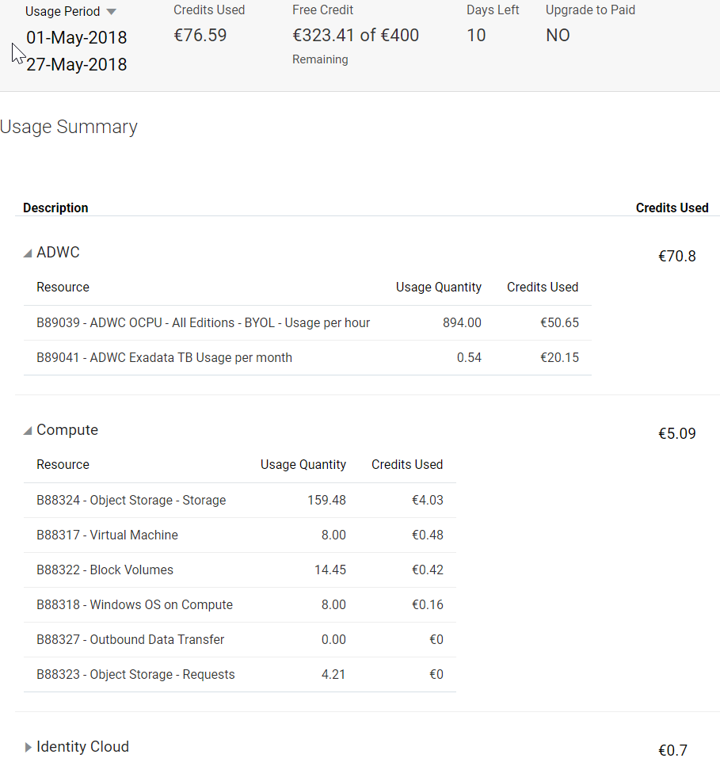
Izgradnja data centra i mogućnosti konzole
Database bare metal i autonomni data warehouse

Slide 5
Database bare metal servis
Database bare metal i autonomni data warehouse
ORACLE SERVER X5-2L
36 CPU (Intel(R) Xeon(R) CPU E5-2699 v3 @ 2,30GHz)
512 GB memorije
9 x 3,2 TB lokalnih NVMe SSD-ova

Slide 6
Database bare metal servis
Database bare metal i autonomni data warehouse
Oracle Database 12c EE Extreme Perf Release 12.2.0.1.0 (single tenant)
Provizionirano za 90-ak minuta
BEGIN DBMS_RESOURCE_MANAGER.CALIBRATE_IO (9, 10, iops, mbps, lat);
max_iops = 392 260
latency = 0
max_mbps = 20 129

Slide 7
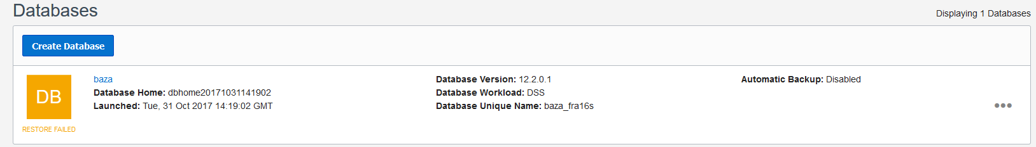
Backup i restore
Database bare metal i autonomni data warehouse
Baza veličine 1,1 TB
Defaultne RMAN postavke – 5 kanala, maxpiecesize 2G
Kroz konzolu (objektni storage)
Backup i restore: 130 minuta
Pomoću skripte (direktno na ASM RECO disk grupu)
Backup i restore: 11 minuta

Slide 8
Testirali smo in-memory
Database bare metal i autonomni data warehouse
Brzina punjenja tablica u memoriji
  inmemory_priority=critical
inmemory_max_populate_servers | GB/h
2 | 2,2
6 | 23,5

Slide 9
Testirali smo in-memory - memkompresija
Database bare metal i autonomni data warehouse

Slide 10
Testirali smo in-memory - memkompresija
Database bare metal i autonomni data warehouse
select distinct dbdate from INMEMORY.TABLICA (313 840 rows selected)

Slide 11
Testirali smo in-memory
Database bare metal i autonomni data warehouse

Slide 12
Testirali smo in-memory
Database bare metal i autonomni data warehouse

Slide 13
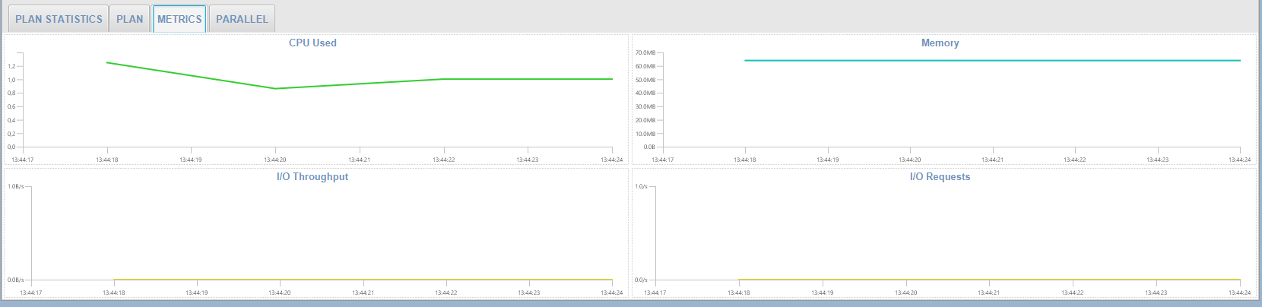
Testirali smo in-memory
Database bare metal i autonomni data warehouse

Slide 14
Swingbench
Database bare metal i autonomni data warehouse
Stres test – 300 sessiona

Slide 15
Swingbench
Database bare metal i autonomni data warehouse
Stres test – 300 sessiona
Device: | Tps | Blk_read/s | Blk_wrtn/s | Blk_read | Blk_wrtn
nvme8n1 | 3 184 | 10 | 59 688 | 144 | 895 329
nvme7n1 | 3 348 | 34 | 62 442 | 510 | 936 623
nvme6n1 | 3 274 | 6 | 62 193 | 97 | 932 894
nvme5n1 | 3 295 | 6 | 62 307 | 95 | 934 617
nvme4n1 | 3 425 | 36 | 62 918 | 542 | 943 767
nvme3n1 | 3 357 | 9 | 63 622 | 128 | 954 336
nvme2n1 | 3 289 | 46 | 62 681 | 688 | 940 209
nvme1n1 | 3 576 | 5 | 65 858 | 80 | 987 871
nvme0n1 | 3 391 | 15 | 65 164 | 224 | 977 456

Slide 16
Swingbench
Database bare metal i autonomni data warehouse
SOE test – 300 sessiona

Slide 17
Swingbench
Database bare metal i autonomni data warehouse
SOE test – 300 sessiona
Device: | tps | Blk_read/s | Blk_wrtn/s | Blk_read | Blk_wrtn
nvme8n1 | 285 | 1 258 | 4 570 | 18 864 | 68 552
nvme7n1 | 364 | 1 376 | 4 844 | 20 638 | 72 656
nvme6n1 | 423 | 1 275 | 5 617 | 19 120 | 84 248
nvme5n1 | 289 | 1 275 | 5 617 | 19 120 | 64 744
nvme4n1 | 308 | 1 254 | 4 872 | 18 814 | 73 073
nvme3n1 | 357 | 1 233 | 5 029 | 18 496 | 75 435
nvme2n1 | 202 | 1 306 | 3 634 | 19 585 | 54 513
nvme1n1 | 280 | 1 293 | 4 247 | 19 392 | 63 712
nvme0n1 | 274 | 1 157 | 4 323 | 17 360 | 64 848

Slide 18

Najzabavnije testove smo čuvali za kraj

Slide 19
Testirali smo autonomni data warehouse
Database bare metal i autonomni data warehouse
Provizionirano za 84 s
Skaliranje 7 CPU (memorija i I/O)

Slide 20

Testirali smo autonomni data warehouse
Database bare metal i autonomni data warehouse
Nema indexa i particija*

Slide 21
Što je ispod?
Database bare metal i autonomni data warehouse
12 storage cellova (gv$cell)
8 db nodeova (gv$active_instances)
Ukupno 1029 TB
86 TB po storage cellu
X6-2 ?

Slide 22
Automatski backup
Database bare metal i autonomni data warehouse

Slide 23
Importali smo 233 GB (451 GB)
Database bare metal i autonomni data warehouse
Kopiranje na objektni storage | Brzina
1 prozor | 16 GB/h
5 prozora (max) | 34,2 GB/h

Slide 24
Usporedili smo performanse
Database bare metal i autonomni data warehouse
TABLE NAME | COUNT | SIZE (MB)
F_USAGE | 3 378 020 537 | 238 016
D_CALL_MIXES | 33 | 0,1
D_MONTHS | 267 | 0,1
D_BRANDS | 20 | 0,1
H_PROVIDERS | 2 587 | 0,1
D_HANDSETS | 179 160 | 3
D_CELLS | 169 654 | 3
D_USAGE_DESTINATIONS | 28 005 | 0,2
D_USAGE_DETAILS | 17 110 | 0,1
D_BILLING_DESTINATIONS | 521 | 0,1

Slide 25
Usporedili smo performanse -100 redaka
Database bare metal i autonomni data warehouse

Slide 26
Usporedili smo performanse - CTAS
Database bare metal i autonomni data warehouse
UPIT | COUNT | SIZE CLOUD MB | SIZE ON PREMISE MB
VOI | 1 264 042 | 113 | 1 371
DAT | 7 198 047 | 776 | 7 617
SMS | 346 841 | 23 | 344
MMS | 2 396 | 0,3 | 3
OTH | 58 599 | 4 | 62
VID | 0 | 0 | 0
VOI_MJESEC | 34 973 554 | 4 544 | 36 842

Slide 27
Usporedili smo performanse - CTAS
Database bare metal i autonomni data warehouse

Slide 28
Usporedili smo performanse - CTAS
Database bare metal i autonomni data warehouse

Slide 29
Usporedili smo performanse – result cache
Database bare metal i autonomni data warehouse

Slide 30
Usporedili smo performanse – result cache
Database bare metal i autonomni data warehouse

Slide 31
Usporedili smo performanse – result cache
Database bare metal i autonomni data warehouse

Slide 32
Usporedili smo performanse
Database bare metal i autonomni data warehouse

Slide 33
Bugovi na koje smo naišli i potencijalni problemi
Database bare metal i autonomni data warehouse
Import (character set konverzija)
Restore - SR 3-17636359941
Resource manager (max_idle_time)
Firewall na load balanceru
Job na bazi se vrti serijski
SLA
Izolacija

Slide 34
Kada sumiramo
Database bare metal i autonomni data warehouse
Konzola i provisioning
Patching i security
Backup i restore
Performanse

Slide 35
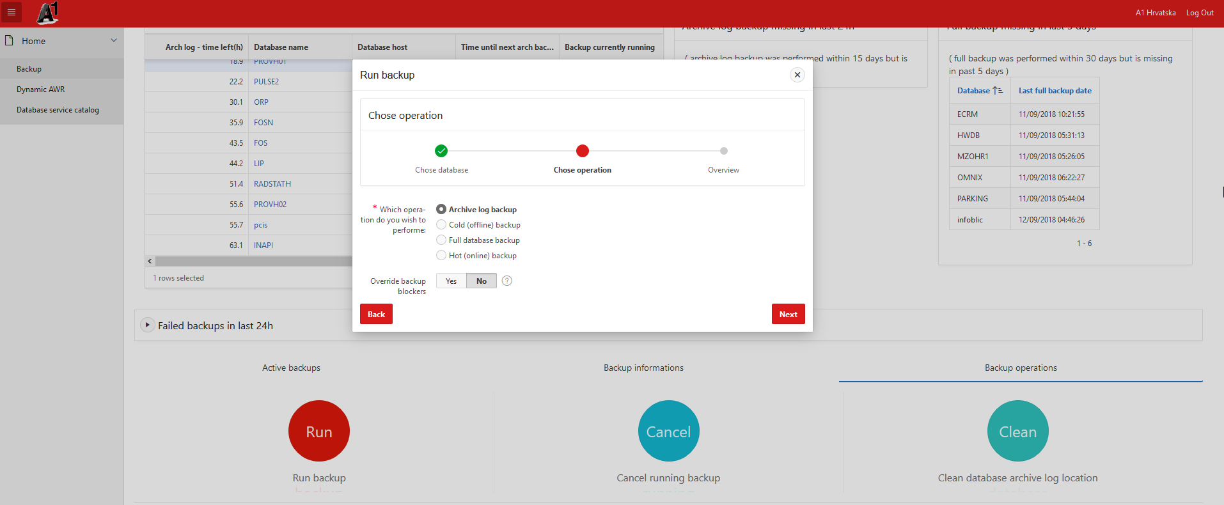
Oracle DBA u budućnosti
Database bare metal i autonomni data warehouse

Slide 36
Hvala

