Slide 1
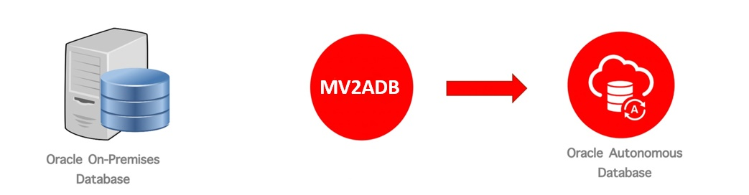


Data Domain d. o. o.
MV2ADB
Migration to Autonomous Database
01 / 18

Slide 2







Data Domain d. o. o.
About us
We are Oracle Hospitality Database Support & Implementation specialists.
Certified Oracle Database Specialists – Oracle 8I to Oracle 12c.
Certified Oracle Cloud Architects with Autonomous Database Certification.
We are centrally located in Croatia (Korčula).
3 DBA’s in Croatia and 2 DBA’s in India to provide 24/7 support.
2/ 18

Slide 3
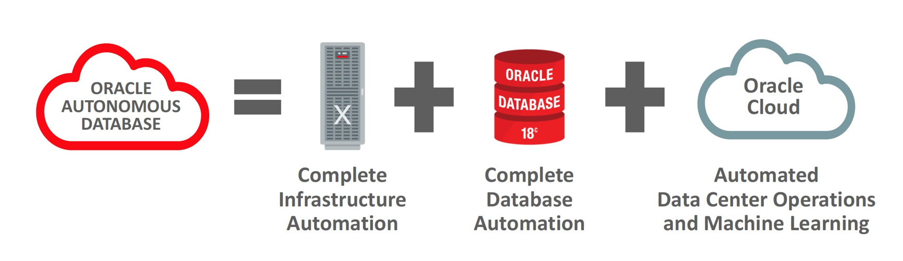
Data Domain d. o. o.
Autonomous Database
Workload types of Autonomous DB:
Autonomous Transaction Processing
Autonomous Data Warehouse
Autonomous JSON Database
Oracle APEX Application Development (APEX Service)
Infrastructure options:
Shared
Dedicated
Cloud@Customer
3/ 18

Slide 4
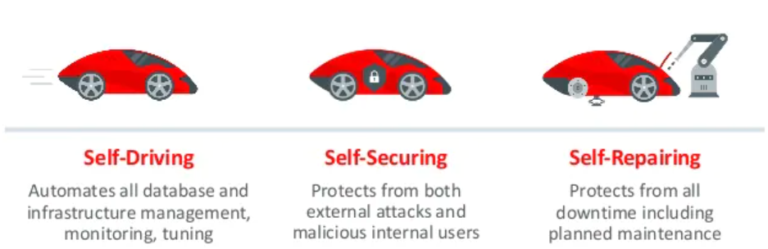
Data Domain d. o. o.
Benefits of
Autonomous Database
Maximum database uptime, performance, and security―including automatic patches and fixes
Elimination of manual, error-prone management tasks through automation
Reduced costs and improved productivity by automating routine tasks
Auto-Indexing
Auto-Scaling
Auto-Backups
Auto-Patching
Automated Detection and Resolution
Automatic Failover
(DataGuard)
Reduced costs and improved productivity by automating routine tasks
Maximum database uptime and performance
Automated security
4/ 18

Slide 5

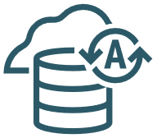


Data Domain d. o. o.
Migration Tools
DBMS_CLOUD
SQL Developer
Data Pump
SQL*Loader
MV2ADB
OCI Data Migration Service
Zero Downtime Migration
Object Storage
Autonomous Database
Customer
Data Center
– on premises
Buckets
5/ 18

Slide 6
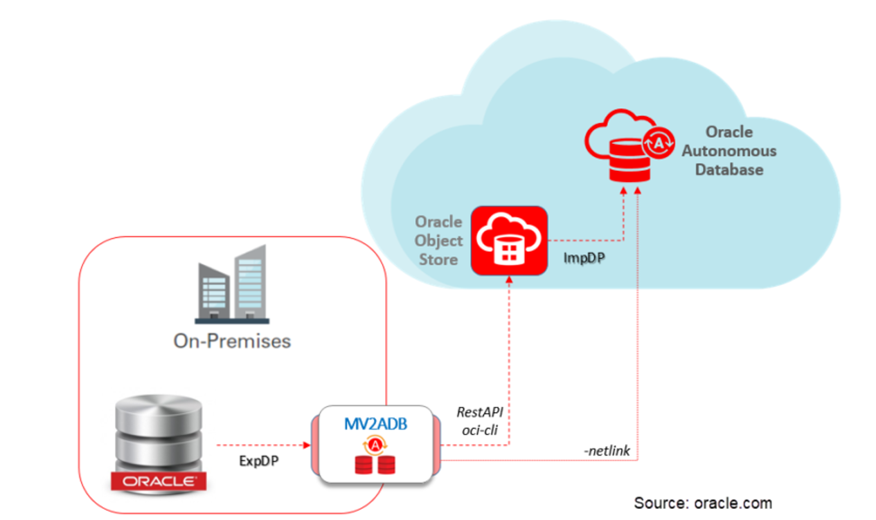
Data Domain d. o. o.
MV2ADB
Advisory tools for migrations to ADB
Oracle Data Pump local export
Transfer into Oracle Cloud Infrastructure Object Store
Oracle Data Pump local import
Verify Oracle Data Pump import logfile
.
6/ 18

Slide 7
Data Domain d. o. o.
Installation & Prerequisites
Mv2adb rpm package installed
HTTP/SQL*Net Connectivity from the on-premises server to ADB
Autonomous Database Wallet + OCI User Auth Token
Perl Release 5.10 or higher
Perl Data-Dumper module
Java executable in the path (If you have an existing installation of Oracle Database version 18.3 or higher, the executable should be added to the path.)
Instant Client 18.3 (if there is an existing Oracle Database 18.3 home or higher installed, you can use it.)
Optional: Oracle Cloud Infrastructure command-line interface
.
7/ 18

Slide 8
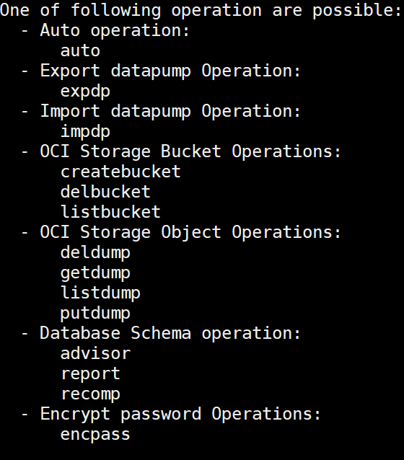
Data Domain d. o. o.
MV2ADB has multiple commands to manage the load/migration data life - cycle from “on premises” to Autonomous Database Cloud.
.
./mv2adb <command> –conf <path>/DBNAME.mv2adb.cfg
9 / 18

Slide 9
Data Domain d. o. o.
MV2ADB – advisor
CPAT
The ADB Schema Advisor is a utility that analyzes your on-premise or cloud Oracle Database schemas for the suitability of migration to the Oracle Autonomous Database.
Using "--premigadvisor" we can leverage on new "Cloud Premigration Advisor Tool (CPAT)"
CPAT is a Java based tool that connects to an Oracle database instance in order to perform a series of checks. Each check is designed to evaluate a particular set of objects or conditions to ensure a successful migration to an Autonomous Database.
The Advisor will run on pre-existing Schema and generates a report that highlights :
The counts of discovered objects and a summary of migration status.
Objects that cannot be migrated to the Autonomous Database due to the restrictions.
The Objects that will migrate with modifications automatically done during the import or the object creation process
Informational section containing certain best practice recommendations and guidance
* CPAT is the recommended aproach as we get a much detailed report with the required actions.
More in the Demo!
8 / 18

Slide 10

Data Domain d. o. o.
MV2ADB – Manual execution
Create an OCI Object Storage Bucket
./mv2adb.bin createbucket –conf <path>/DBNAME.mv2adb.cfg
1.
3.
Upload the Data Pump export files into the OCI Bucket
./mv2adb.bin putdump –conf <path>/DBNAME.mv2adb.cfg
Execute the local Oracle Data Pump export
2.
4.
Import the data
./mv2adb.bin expdp –conf <path>/DBNAME.mv2adb.cfg
./mv2adb.bin impdp –conf <path>/DBNAME.mv2adb.cfg
Verification report
./mv2adb.bin report –conf conf/DBNAME.mv2adb.cfg
10/ 18

Slide 11

Data Domain d. o. o.
MV2ADB –Auto
./mv2adb.bin auto –conf <path>/DBNAME.mv2adb.cfg
Prerequisite:
Create an OCI Object Storage Bucket
./mv2adb.bin createbucket –conf <path>/DBNAME.mv2adb.cfg
Upload the Data Pump export files into the OCI Bucket
Local Storage
Buckets
Autonomous Database
Execute the local Oracle Data Pump export
Import the data
Verification report
./mv2adb.bin report –conf conf/DBNAME.mv2adb.cfg
11 / 18

Slide 12
Data Domain d. o. o.
DB_CONSTRING=//datadomainhroug/demodb # Source DB connect string
SYSTEM_DB_PASSWORD= A63658CD5B51039F29CB0386CDD58C62
# Source Database 'system’
DBV_USER= system #Source Database Vault User as replacement of sys as sysdba
SCHEMAS=dummy # Comma separated schemas to export/import
FULL= # FULL=Y for full expdp
EXCLUDE= # Comma separated schemas to be excluded
REMAP= # Comma separated remap SOURCE_TBS:TARGET_TBS
DUMP_NAME= test_expdp # ExpDP dump file name
DUMP_PATH= /opt/mv2adb/dump # ExpDP dump file path
DUMP_FILES= # Comma separated dump files
OHOME= /u01/app/oracle/product/19.0.0/dbhome_1/ # RDBMS Oracle Home
ICHOME= /u01/app/oracle/product/19.0.0/dbhome_1/ # Instant Client Oracle
Home with auto/impdp
CONFIG FILE
- DB Parameters
./mv2adb.bin encpass
Please enter the password :
Please re-enter the password :
A63658CD5B51039F29CB0386CDD58C62
12/ 18

Slide 13
Data Domain d. o. o.
CONFIG FILE
- EXPDP/IMPDP Parameters
COMPRESSION= # Expdp compression type {ALL | DATA_ONLY| METADATA_ONLY | NONE}
*EXTRA_EXPDP= EXCLUDE=JAVA_CLASS,JAVA_RESOURCE,JAVA_SOURCE
# Extra expdp parameters
*EXTRA_IMPDP= # Extra impdp parameters
JOB_NAME= # Expdp/Impdp job name (Default: MV2ADB_JOB)
ENC_PASSWORD= # Expdp/Impdp encryption password, must be encrypted by 'mv2adb encpass'
ENC_TYPE=AES256 # Expdp/Impdp encryption type { AES128| AES192
| AES256 }
------------------------------------------------------------------------------------------------------------------------------------------------------------------------------------*lack of documentation on parameter options
13/ 18

Slide 14
Data Domain d. o. o.
CONFIG FILE
- ADB Parameters
ADB_NAME= DataDomainADB # Database name
ADB_PASSWORD= 276DE89EEAF511C9268742277196EEF6 # ADB Database 'admin' password
ADB_CORES= # Optional (skip auto check)
ADB_TARGET= ATP # Optional in use with 'advisor’ command {ADW|ATP|ATPD}
ADB_CFILE= /opt/mv2adb/wallet/Wallet_DataDomainADB.zip # Credential zip file
14 / 18

Slide 15
Data Domain d. o. o.
CONFIG FILE
- Object store & OCI-Client Properties
SQL_PROXY_HOST= # Optional to connect ADB (SQL*Net) by proxy
SQL_PROXY_PORT= # Optional to connect ADB (SQL*Net) by proxy
# Object Store Properties
OCI_REGION= eu-frankfurt-1 # mandatory if OCIC=false or not defined
OCI_NAMESPACE=frykrmssxoyeh # mandatory if OCIC=false or not defined
OCI_BUCKET=DataDomainBucket # mandatory
OCI_ID= oracleidentitycloudservice/ines.kapor@datadomain.hr
# Oracle Database Backup Cloud Service account
OCI_PASSWORD= EC05EB5BD9CA97687E8D3B6FFE3D5A579557F1444CBB46B6F21C2597BD17DD0A
# Auth Tokens password for the OCI account, must be encrypted by ‘encpass’
PROXY_HOST= # Optional for Object Storage Connectivity
PROXY_PORT= # Optional for Object Storage Connectivity
PROXY_ID= # Optional for Object Storage Connectivity
PROXY_PASSWORD= # Optional for Object Storage Connectivity, must be encrypted by 'mv2adb encpass’
# OCI-Client Properties
OCIC= # Optional, if true oci-client will be used
OCIC_SIZE= # Split file size Mb (Default: 128)
OCIC_PARALLEL= # Parallel upload count (Default: 3)
OCIC_COMPART_ID= # Oracle Object Store Compartment (required with list/create bucket using oci-cli)
15/ 18

Slide 16


Data Domain d. o. o.
DEMO
MV2ADB
Preconfigured tasks:
Creation of Autonomous Database
Wallet configured + OCI User Auth Token configure
Installed MV2ADB utility
Mv2adb config file filled
16/18

Slide 17
Data Domain d. o. o.
References
[1] https://docs.oracle.com/en/solutions/migrate-to-autonomous-database-with-mv-to-adb/index.html
[2] MV2ADB: move data to Autonomous Database in "one-click" (Doc ID 2463574.1)
[3] https://www.martinberger.com/2019/12/mv2adb-one-click-move-of-your-data-into-oci-autonomous-databases/
[4] https://docs.oracle.com/en/solutions/migrate-to-autonomous-database-with-mv-to-adb/migrate-data1.html
17/18

Slide 18
















Data Domain d. o. o.
Oracle Hospitality Clients:
Q&A
Thank you for your attention!
Oracle Database support Clients and Partners:
Client Showcase
Domagoj Šain
(domagoj.sain@datadomain.hr)
&
Ines Kapor
(ines.kapor@datadomain.hr)
Data Domain d.o.o
https://datadomain.hr/
22 / 39
18/18

