Slide 1
One PDB to go, please!
Christian Gohmann MakeIT Autumn, 11. October 2021

Slide 2
One PDB to go, please!
Christian Gohmann HrOUG Conference, 13. October 2021

Slide 3
HALLO, GRÜEZI, HI!
Christian Gohmann
Principal Consultant, Instructor and Tool Owner of db*BACKUP
Working with Oracle since 2006
Focused on High Availability Solutions, Migration Projects, Backup & Recovery and Cloud Technologies
Oracle ACE

Slide 4
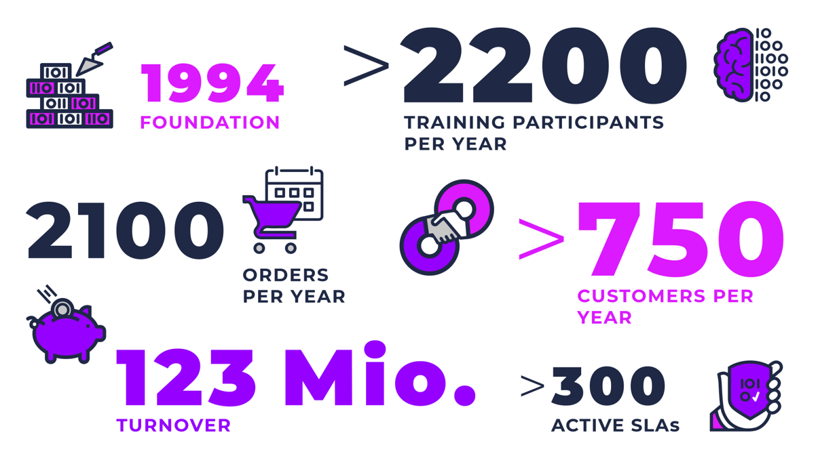

Slide 5
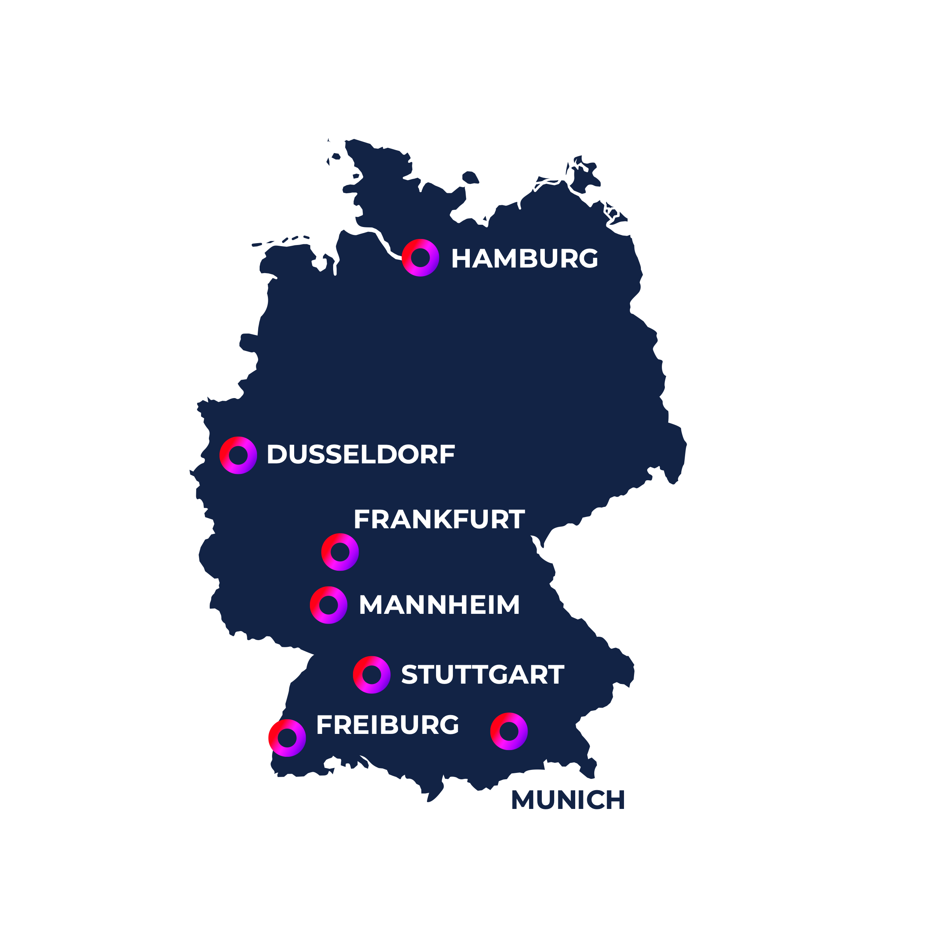
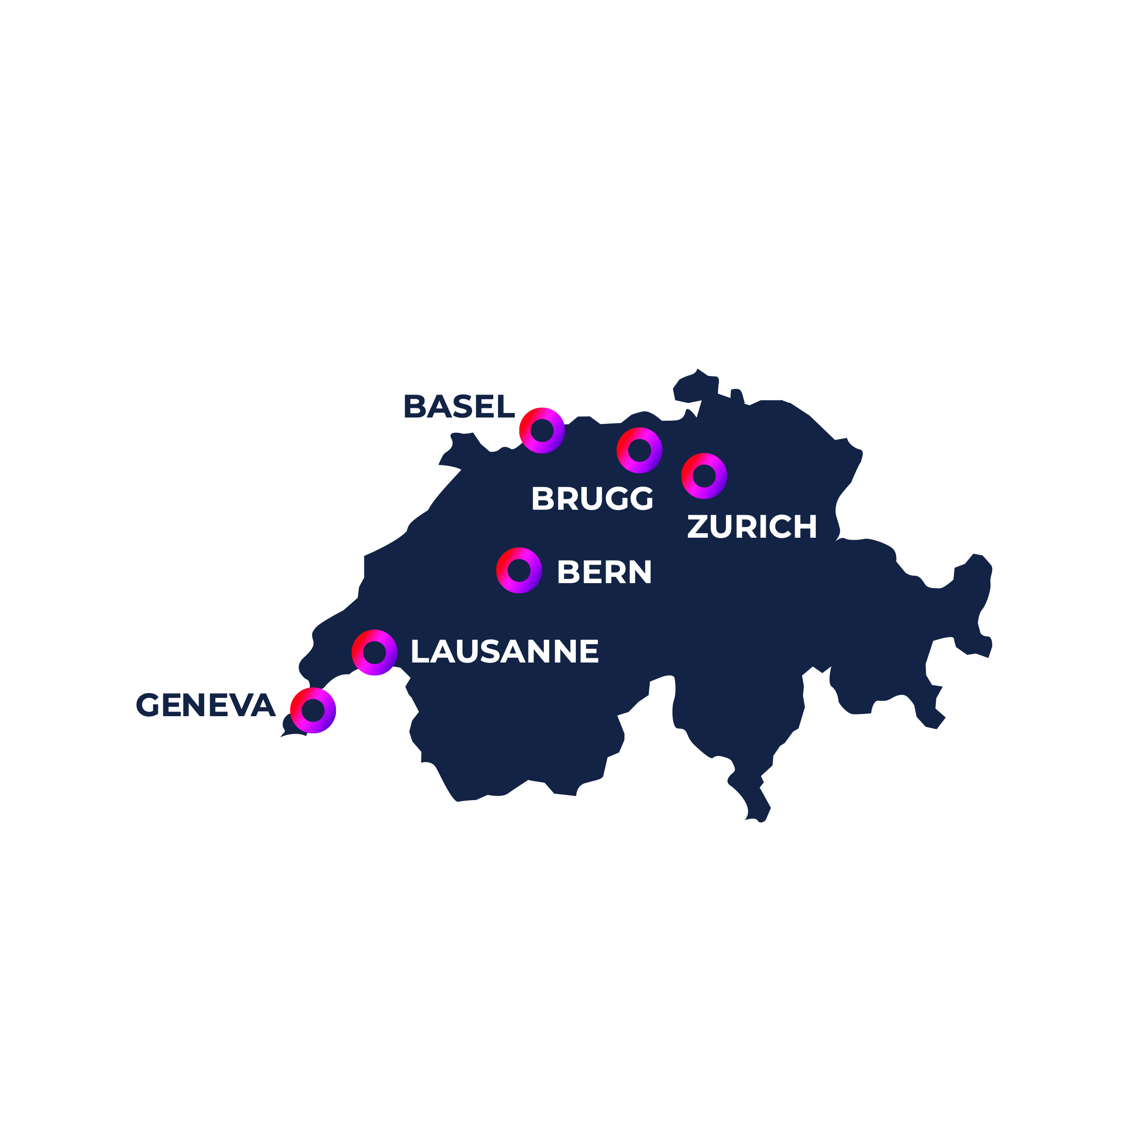
OUR Workspaces
GERMANY
AUSTRIA
ROMANIA
SWITZERLAND

Slide 6
Agenda
Local / Remote Cloning
Unplug / Plug-in PDB
Refreshable PDB
Snapshot Carousel
RMAN Enhancements

Slide 7
Local / Remote cloning

Slide 8
Requirements & Restrictions 1/2
User with CREATE PLUGGABLE DATABASE privilege is required
Source PDB must be opened read-only or read-write
For <= 12.1.0.2 read-only was the only supported way
Local Undo Mode is required to use a read-write PDB (>= Oracle 12c Release 2)
CDB must run in ARCHIVELOG Mode
Cloning with NOARCHIVELOG Mode is possible, but neither supported nor documented
Character set, endianness and the same installed options are required
Starting with 12c Release 2 the target character set of the CDB can be a superset
Notes:
Activate Local Undo
SQL> SHUTDOWN IMMEDIATE
SQL> STARTUP UPGRADE
SQL> ALTER DATABASE LOCAL UNDO ON;
SQL> SHUTDOWN IMMEDIATE
SQL> STARTUP
If Local Undo Mode is disabled, a Hot Clone fails with an ORA-65035 exception.
SQL> CREATE PLUGGABLE DATABASE PDB1_LOCAL_CLONE FROM PDB1;
CREATE PLUGGABLE DATABASE PDB1_LOCAL_CLONE FROM PDB1
*
ERROR at line 1:
ORA-65035: unable to create pluggable database from PDB1

Slide 9
Requirements & Restrictions 2/2
If the target CDB has a higher version, the PDB must be upgraded
Downgrading a PDB is not possible
$> $ORACLE_HOME/bin/dbupgrade -c PDB01

Slide 10
Local Cloning 1/2
Clones an existing PDB within the same CDB
After the cloning the new PDB is closed
A default service named by the PDB is automatically created (don‘t use it)
Easiest way is to use Oracle Managed Files (OMF)
To use a different OMF location, use CREATE_FILE_DEST parameter
For non-OMF paths, use FILE_NAME_CONVERT parameter to adjust paths
Example
SQL> CREATE PLUGGABLE DATABASE PDB2 FROM PDB1;
SQL> CREATE PLUGGABLE DATABASE PDB2 FROM PDB1 CREATE_FILE_DEST='/u02/oradata';
NO DATA keyword can be used to create a clone without data.

Slide 11
Local Cloning 2/2
Starting with 18c DBCA can be used to clone a local PDB or to plug-in a PDB
Only available in silent mode
$> dbca -silent –createPluggableDatabase –sourceDB CDB1 \
–createPDBFrom PDB –pdbName PDB01_CLONE –sourcePDB PDB01
Prepare for db operation
13% complete
Creating Pluggable Database
15% complete
19% complete
23% complete
31% complete
53% complete
Completing Pluggable Database Creation
60% complete
Executing Post Configuration Actions
100% complete
Pluggable database "PDB01_CLONE" plugged successfully.
Look at the log file "/u00/app/oracle/cfgtoollogs/dbca/CDB1/PDB01_CLONE/CDB1.log" for further details.

Slide 12
Snapshot Copy 1/2
Instead of copying all datafiles belonging to the PDB, a storage snapshot is used
New PDB depends on the storage snapshot
Unplugging a PDB based on a snapshot is not possible
Dropping the PDB snapshot is not possible
Storage snapshots are supported by ACFS, ZFS Storage Appliance and Direct NFS Client storage
On Exadata ASM configured with sparse ASM Grid Disks is also supported
SQL> CREATE PLUGGABLE DATABASE PDB1 … SNAPSHOT COPY;
Notes:
Exadata supports snapshot copy functionality on ASM configured with sparse ASM grid disks.

Slide 13
Snapshot Copy 2/2
A snapshot copy PDB can be materialized to remove the dependency to the used storage snapshot
Storage snapshots are supported by ACFS and ZFS Storage Appliance
Local file systems, network file systems (NFS) or clustered file systems with enabled DirectNFS can be used, when they support sparse files
Initialization parameter CLONEDB must be set to TRUE
SQL> ALTER PLUGGABLE DATABASE MATERIALIZE;
SQL> ALTER SYSTEM SET clonedb = TRUE SCOPE = SPFILE;
On local file systems, PDB must be read-only during snapshot clone (< 19c).

Slide 14
Remote Cloning 1/2
Clones an existing PDB of a remote CDB into the local CDB
Cloning a non-CDB into a PDB is also possible when the source database is 12c or higher
A Database Link is used to connect to the remote (non-)CDB
Remote user can be either a common or local user (in the target PDB)
Minimum privileges: CREATE SESSION, CREATE PLUGGABLE DATABASE
Example:
Add keyword AS PROXY to create a Proxy PDB (Oracle 12c Release 2)
SQL> CREATE PLUGGABLE DATABASE PDB1_CLONE FROM PDB1@SOURCE_PDB;
SQL> ALTER PLUGGABLE DATABASE PDB1_CLONE OPEN;
After cloning a non-CDB run $ORACLE_HOME/rdbms/admin/noncdb_to_pdb.sql to upgrade the Data Dictionary of the new PDB (< 21c, Replay Upgrade).
Notes:
Create User in Source PDB
CREATE USER source_user IDENTIFIED BY source_user;
GRANT CREATE SESSION, CREATE PLUGGABLE DATABASE TO source_user;
CREATE USER c##source_user IDENTIFIED BY source_user CONTAINER=ALL;
GRANT CREATE SESSION, CREATE PLUGGABLE DATABASE TO c##source_user CONTAINER=ALL;
Starting with 21c PDBs are automatically upgraded when they are opened for the first time. This feature is called Replay Upgrade.
Enabled by default, but can be disabled.
SQL> ALTER DATABASE UPGRADE SYNC OFF;

Slide 15
Remote Cloning 2/2
With 19c a remote clone can be created with the DBCA in silent mode
$> dbca -silent -createPluggableDatabase -sourceDB CDB2 -pdbName PDB01_CLONE \
-createFromRemotePDB -remotePDBName PDB01 -remoteDBConnString "CDB1.world" \
-remoteDBSYSDBAUserName SYS -remoteDBSYSDBAUserPassword manager \
-dbLinkUsername SYSTEM -dbLinkUserPassword manager
Prepare for db operation
50% complete
Create pluggable database using remote clone operation
100% complete
Pluggable database "PDB01_CLONE" plugged successfully.
Look at the log file "/u00/app/oracle/cfgtoollogs/dbca/CDB2/PDB01_CLONE/CDB21.log" for further details.
TNS Alias or EZCONNECT
Do not use SYS as user for the database link.
Notes:
Database link is not removed if the clone operation failed

Slide 16
PDB Unplug / Plug-in

Slide 17
PDB Unplug 1/2
Disassociates a PDB from its CDB
An unplugged PDB is still part of the CDB and its backup
The only operation for an unplugged PDB is DROP PLUGGABLE DATABASE
Easy way to move one PDB to another CDB
Or as archive solution instead of a final Data Pump dump
An unplugged PDB can be used as base for new PDBs
Two ways to unplug a PDB, depending on the used file extension
XML Metadata File: XML Manifest and Datafiles must be copied separately
PDB Archive File: Compressed archive with XML Manifest and Datafiles
PDB Archive Files were introduced with Oracle 12c Release 2. Usage requires additional time and CPU resources.

Slide 18
PDB Unplug 2/2
Example
SQL> ALTER PLUGGABLE DATABASE PDB1 CLOSE IMMEDIATE INSTANCES = ALL;
-- XML Metadata File
SQL> ALTER PLUGGABLE DATABASE PDB1 UNPLUG INTO '/stage/pdb1_20180913.xml';
-- PDB Archive File
SQL> ALTER PLUGGABLE DATABASE PDB1 UNPLUG INTO '/stage/pdb1_20180913.pdb';
You can change the file extension from .pdb to .zip and extract all files (XML File, Datafiles) with an unzip tool.

Slide 19
PDB Plug-in
Creates a new PDB based on the unplugged PDB
Datafiles are copied (default) or moved to the correct location (e.g OMF location) or will stay at the current location if NOCOPY is used
Check Plug-in compatibility with DBMS_PDB.CHECK_PLUG_COMPATIBILITY
Violations are visible through PDB_PLUG_IN_VIOLATIONS view
Search for entries with status PENDING, purging was introduced with 18c
-- XML Metadata File
SQL> CREATE PLUGGABLE DATABASE PDB1 USING '/stage/pdb1_20180913.xml' NOCOPY;
-- PDB Archive File
SQL> CREATE PLUGGABLE DATABASE PDB1 USING '/stage/pdb1_20180913.pdb' MOVE;
Use AS CLONE to plug in one unplugged PDB multiple times to avoid ORA-65122.
Notes:
If a PDB Archive File was already plugged in, every subsequent try will fail except AS CLONE is used
SQL> CREATE PLUGGABLE DATABASE PDB23 USING '/tmp/pdb3_20180913.pdb'
*
ERROR at line 1:
ORA-65122: Pluggable database GUID conflicts with the GUID of an existing container.
Purging of RESOLVED entries
SQL> exec DBMS_PDB.CLEAR_PLUGIN_VIOLATIONS( pdb_name => 'PDB1' );

Slide 20
Refreshable PDB

Slide 21
Refreshable PDB
Introduced with Oracle 12c Release 2 (Engineered Systems and Cloud only)
Read-only clone of an existing PDB, which is refreshed in a regular interval
Refreshable PDB must be closed during each Refresh
Uses a Database Link to connect to source PDB
Archive Logs and Redo information are used to synchronize the Refreshable PDB
Role conversion (switchover) is possible with Oracle 18c, but no direct failover
Last sync of Redo information from source PDB is required
Conversion of a Refreshable PDB to a normal PDB is possible, but not vice-versa
SQL> ALTER PLUGGABLE DATABASE PDB01 REFRESH MODE MANUAL
FROM REFRESH_PDB@TARGET_PDB SWITCHOVER;
Foreign Archive Logs are written to the subdirectory foreign_archivelog (OMF) within the Fast Recovery Area.
Notes:
Try to open a Refreshable PDB read-write fails with ORA-65341
SQL> alter pluggable database pdb1_remote_clone open;
alter pluggable database pdb1_remote_clone open
*
ERROR at line 1:
ORA-65341: cannot open pluggable database in read/write mode
PDB Switchover
ALTER PLUGGABLE DATABASE REFRESH MODE MANUAL FROM PDB01_REF@TARGET SWITCHOVER;

Slide 22
Refresh Modes 1/2
Provide RESFRESH MODE keyword to create a Refreshable PDB
Supported Refresh Modes:
NONE (default, deactivated)
MANUAL
EVERY x MINUTES | HOURS (1 Minute is the lowest possible interval)
SQL> CREATE PLUGGABLE DATABASE REFRESH_PDB FROM PDB1@SOURCE_PDB
REFRESH MODE MANUAL;
-- If required, you can open the Refreshable PDB read-only.
SQL> ALTER PLUGGABLE DATABASE REFRESH_PDB OPEN READ ONLY;
Current configuration is visible in the columns REFRESH_MODE and REFRESH_INTERVAL of DBA_PDBS.
Notes:
If the Refreshable PDB is not closed on all instances, a Refresh will fail.
SQL> alter pluggable database pdb1_remote_clone refresh;
alter pluggable database pdb1_remote_clone refresh
*
ERROR at line 1:
ORA-65025: Pluggable database PDB1_REMOTE_CLONE is not closed on all instances.
2018-09-11T14:55:12.610165+02:00
alter pluggable database pdb1_remote_clone refresh
2018-09-11T14:55:14.489937+02:00
Applying media recovery for pdb-4099 from SCN 4803260 to SCN 4803267
Remote log information: count-1
thr-1, seq-64, logfile-/u00/app/oracle/fast_recovery_area/L18CEEC1/foreign_archivelog/PDB1/2018_09_11/o1_mf_1_64_502165962_.arc, los-4803159, nxs-18446744073709551615
PDB1_REMOTE_CLONE(4):Media Recovery Start
2018-09-11T14:55:14.490487+02:00
PDB1_REMOTE_CLONE(4):Serial Media Recovery started
PDB1_REMOTE_CLONE(4):max_pdb is 5
2018-09-11T14:55:14.582339+02:00
PDB1_REMOTE_CLONE(4):Media Recovery Log /u00/app/oracle/fast_recovery_area/L18CEEC1/foreign_archivelog/PDB1/2018_09_11/o1_mf_1_64_502165962_.arc
2018-09-11T14:55:14.717201+02:00
PDB1_REMOTE_CLONE(4):Incomplete Recovery applied until change 4803267 time 09/11/2018 14:55:12
2018-09-11T14:55:14.721876+02:00
PDB1_REMOTE_CLONE(4):Media Recovery Complete (L18CEEC2)
Completed: alter pluggable database pdb1_remote_clone refresh
SQL> alter pluggable database pdb1_remote_clone open;
alter pluggable database pdb1_remote_clone open
*
ERROR at line 1:
ORA-65341: cannot open pluggable database in read/write mode
SQL> alter pluggable database pdb1_remote_clone refresh
2 ;
alter pluggable database pdb1_remote_clone refresh
*
ERROR at line 1:
ORA-17627: ORA-12514: TNS:listener does not currently know of service requested
in connect descriptor
ORA-17629: Cannot connect to the remote database server
SQL> alter pluggable database pdb1_remote_clone refresh mode none;
alter pluggable database pdb1_remote_clone refresh mode none
*
ERROR at line 1:
ORA-17627: ORA-12514: TNS:listener does not currently know of service requested
in connect descriptor
ORA-17629: Cannot connect to the remote database server
alter system set remote_recovery_file_dest='/tmp'
*
ERROR at line 1:
ORA-01219: database or pluggable database not open: queries allowed on fixed
tables or views only
SQL> alter pluggable database open read only;
Pluggable database altered.
SQL> alter system set remote_recovery_file_dest='/tmp';
System altered.
SQL> alter pluggable database refresh;
alter pluggable database refresh
*
ERROR at line 1:
ORA-65025: Pluggable database PDB1_REMOTE_CLONE is not closed on all instances.
SQL> alter pluggable database close immediate;
Pluggable database altered.
2018-09-11T17:13:54.556194+02:00
Remote log information: count-0
No matching archive logs found. Nothing to refresh from
PDB1_REMOTE_CLONE(3):Completed: alter pluggable database refresh
2018-09-11T17:18:27.989179+02:00
PDB1_REMOTE_CLONE(3):alter pluggable database refresh
2018-09-11T17:18:28.028655+02:00
Remote log information: count-1
Applying media recovery for pdb-0 from SCN 4810346 to SCN 4810379
thr-1, seq-75, logfile-/tmp/o1_mf_1_75_fshpzdsd_.arc, los-4809784, nxs-4810379
PDB1_REMOTE_CLONE(3):Media Recovery Start
2018-09-11T17:18:28.031580+02:00
PDB1_REMOTE_CLONE(3):Serial Media Recovery started
PDB1_REMOTE_CLONE(3):max_pdb is 5
2018-09-11T17:18:28.197464+02:00
PDB1_REMOTE_CLONE(3):Media Recovery Log /tmp/o1_mf_1_75_fshpzdsd_.arc
2018-09-11T17:18:28.258578+02:00
PDB1_REMOTE_CLONE(3):Incomplete Recovery applied until change 4810379 time 09/11/2018 17:12:48
2018-09-11T17:18:28.275099+02:00
PDB1_REMOTE_CLONE(3):Media Recovery Complete (L18CEEC2)
PDB1_REMOTE_CLONE(3):Completed: alter pluggable database refresh
2018-09-11T17:19:06.047359+02:00
PDB1_REMOTE_CLONE(3):alter pluggable database refresh
2018-09-11T17:19:06.057151+02:00
Remote log information: count-1
Applying media recovery for pdb-0 from SCN 4810379 to SCN 4810379
thr-1, seq-75, logfile-/tmp/o1_mf_1_75_fshpzdsd_.arc, los-4809784, nxs-4810379
PDB1_REMOTE_CLONE(3):Media Recovery Start
2018-09-11T17:19:06.057934+02:00
PDB1_REMOTE_CLONE(3):Serial Media Recovery started
PDB1_REMOTE_CLONE(3):max_pdb is 5
PDB1_REMOTE_CLONE(3):Media Recovery Not Required
PDB1_REMOTE_CLONE(3):Completed: alter pluggable database refresh

Slide 23
Refresh Modes 2/2
For the automatic Refresh, a DBMS Scheduler Job is created to initiate the Refresh
SQL> SELECT owner, job_name, repeat_interval
FROM dba_scheduler_jobs
WHERE job_name like '%REFRESH';
OWNER JOB_NAME REPEAT_INTERVAL
----- ------------------------------- ------------------------------
SYS REFRESH_PDB_4204314029_REFRESH FREQ = MINUTELY; INTERVAL = 1
PDB Name
PDB DBID
The PDB is not closed automatically.
Notes:
Job Action of Refresh Job
DECLARE
cur INTEGER := SYS.DBMS_SQL.OPEN_CURSOR(security_level => 2);
BEGIN
SYS.DBMS_SQL.PARSE(
c => cur,
statement => 'alter pluggable database refresh',
language_flag => sys.dbms_sql.native,
container => 'PDB1_REMOTE_CLONE');
SYS.DBMS_SQL.CLOSE_CURSOR(c=>cur);
END;

Slide 24
Alternate Archive Log Source
If Archive Logs are missing, Refresh will fail with generic ORA-65345 error
Solutions:
Restore Archive Logs on the source site to their original location
Set parameter REMOTE_RECOVERY_FILE_DEST within Refreshable PDB to the location of the restored Archive Logs
ORA-65345: cannot refresh pluggable database
SQL> ALTER SESSION SET CONTAINER = REFRESH_PDB;
SQL> ALTER PLUGGABLE DATABASE OPEN READ ONLY;
SQL> ALTER SYSTEM SET remote_recovery_file_dest = '/u01/arcs';
SQL> ALTER PLUGGABLE DATABASE CLOSE IMMEDIATE;
If REMOTE_RECOVERY_FILE_DEST is set, only Archive Logs in the provided location are considered for Recovery.
Notes:
Recovery of Archive Logs located at the directory defined by REMOTE_RECOVERY_FILE_DEST
2018-09-11T17:13:54.556194+02:00
Remote log information: count-0
No matching archive logs found. Nothing to refresh from
PDB1_REMOTE_CLONE(3):Completed: alter pluggable database refresh
2018-09-11T17:18:27.989179+02:00
PDB1_REMOTE_CLONE(3):alter pluggable database refresh
2018-09-11T17:18:28.028655+02:00
Remote log information: count-1
Applying media recovery for pdb-0 from SCN 4810346 to SCN 4810379
thr-1, seq-75, logfile-/tmp/o1_mf_1_75_fshpzdsd_.arc, los-4809784, nxs-4810379
PDB1_REMOTE_CLONE(3):Media Recovery Start
2018-09-11T17:18:28.031580+02:00
PDB1_REMOTE_CLONE(3):Serial Media Recovery started
PDB1_REMOTE_CLONE(3):max_pdb is 5
2018-09-11T17:18:28.197464+02:00
PDB1_REMOTE_CLONE(3):Media Recovery Log /tmp/o1_mf_1_75_fshpzdsd_.arc
2018-09-11T17:18:28.258578+02:00
PDB1_REMOTE_CLONE(3):Incomplete Recovery applied until change 4810379 time 09/11/2018 17:12:48
2018-09-11T17:18:28.275099+02:00
PDB1_REMOTE_CLONE(3):Media Recovery Complete (L18CEEC2)
PDB1_REMOTE_CLONE(3):Completed: alter pluggable database refresh

Slide 25
Refreshable PDB - Failover
When you try to do a „Failover“ by deactivating the Refresh Mode for the Refreshable PDB, it will fail
With the help of the REMOTE_RECOVERY_FILE_DEST parameter it is possible to do it
SQL> ALTER PLUGGABLE DATABASE REFRESH MODE NONE;
ORA-17627: ORA-12514: TNS:listener does not currently know of service requested
in connect descriptor
ORA-17629: Cannot connect to the remote database server
SQL> ALTER SYSTEM SET remote_recovery_file_dest = '/u01/arcs';
SQL> ALTER PLUGGABLE DATABASE CLOSE IMMEDIATE;
SQL> ALTER PLUGGABLE DATABASE REFRESH MODE NONE;
SQL> ALTER PLUGGABLE DATABASE OPEN READ WRITE;
Empty directory
Because of unpublished Bug 24434583 in 12.2.0.1 reading Archive Logs from the specified location will fail – fixed with 18.1 (Doc ID 2408829.1).
Notes:
SQL> CREATE PLUGGABLE DATABASE PDB1_REMOTE_CLONE FROM PDB1@SOURCE_PDB REFRESH MODE MANUAL;
Pluggable database created.
SQL> alter session set container = PDB1_REMOTE_CLONE;
Session altered.
SQL> ALTER PLUGGABLE DATABASE REFRESH;
ALTER PLUGGABLE DATABASE REFRESH
*
ERROR at line 1:
ORA-17627: ORA-12514: TNS:listener does not currently know of service requested
in connect descriptor
ORA-17629: Cannot connect to the remote database server
SQL> ALTER PLUGGABLE DATABASE REFRESH MODE NONE;
ALTER PLUGGABLE DATABASE REFRESH MODE NONE
*
ERROR at line 1:
ORA-17627: ORA-12514: TNS:listener does not currently know of service requested
in connect descriptor
ORA-17629: Cannot connect to the remote database server
SQL> ALTER PLUGGABLE DATABASE OPEN READ ONLY;
Pluggable database altered.
SQL> ALTER SYSTEM SET remote_recovery_file_dest = '/u01/app/oracle';
System altered.
SQL> ALTER PLUGGABLE DATABASE CLOSE IMMEDIATE;
Pluggable database altered.
SQL> ALTER PLUGGABLE DATABASE REFRESH;
Pluggable database altered.
SQL> ALTER PLUGGABLE DATABASE REFRESH MODE NONE;
Pluggable database altered.
SQL> ALTER PLUGGABLE DATABASE OPEN READ WRITE;
Pluggable database altered.
2018-09-11T17:41:42.293563+02:00
PDB1_REMOTE_CLONE(4):ALTER PLUGGABLE DATABASE REFRESH
2018-09-11T17:41:42.296858+02:00
Remote log information: count-0
No matching archive logs found. Nothing to refresh from
PDB1_REMOTE_CLONE(4):Completed: ALTER PLUGGABLE DATABASE REFRESH
2018-09-11T17:41:46.728071+02:00
PDB1_REMOTE_CLONE(4):ALTER PLUGGABLE DATABASE REFRESH MODE NONE
2018-09-11T17:41:46.731134+02:00
Remote log information: count-0
No matching archive logs found. Nothing to refresh from
PDB1_REMOTE_CLONE(4):Endian type of dictionary set to little
PDB1_REMOTE_CLONE(4):Database Characterset for PDB1_REMOTE_CLONE is AL32UTF8
PDB1_REMOTE_CLONE(4):JIT: pid 4040 requesting stop
PDB1_REMOTE_CLONE(4):Buffer Cache flush started: 4
PDB1_REMOTE_CLONE(4):Buffer Cache flush finished: 4
2018-09-11T17:41:47.291407+02:00
PDB1_REMOTE_CLONE(4):While transitioning the pdb 4 to clean state, clearing all its abort bits in the control file.
PDB1_REMOTE_CLONE(4):Completed: ALTER PLUGGABLE DATABASE REFRESH MODE NONE
2018-09-11T17:41:55.344270+02:00
PDB1_REMOTE_CLONE(4):ALTER PLUGGABLE DATABASE OPEN READ WRITE
2018-09-11T17:41:55.598718+02:00
PDB1_REMOTE_CLONE(4):Endian type of dictionary set to little
PDB1_REMOTE_CLONE(4):Deleting old file#42 from file$
PDB1_REMOTE_CLONE(4):Deleting old file#43 from file$
PDB1_REMOTE_CLONE(4):Deleting old file#44 from file$
PDB1_REMOTE_CLONE(4):Deleting old file#57 from file$
PDB1_REMOTE_CLONE(4):Adding new file#39 to file$(old file#42). fopr-1, newblks-26880, oldblks-26880
PDB1_REMOTE_CLONE(4):Adding new file#40 to file$(old file#43). fopr-1, newblks-23680, oldblks-21120
PDB1_REMOTE_CLONE(4):Adding new file#41 to file$(old file#44). fopr-1, newblks-28160, oldblks-7680
PDB1_REMOTE_CLONE(4):Adding new file#42 to file$(old file#57). fopr-1, newblks-1280, oldblks-1280
PDB1_REMOTE_CLONE(4):Successfully created internal service PDB1_REMOTE_CLONE at open
****************************************************************
Post plug operations are now complete.
Pluggable database PDB1_REMOTE_CLONE with pdb id - 4 is now marked as NEW.
****************************************************************
PDB1_REMOTE_CLONE(4):Pluggable database PDB1_REMOTE_CLONE dictionary check beginning
PDB1_REMOTE_CLONE(4):Pluggable Database PDB1_REMOTE_CLONE Dictionary check complete
PDB1_REMOTE_CLONE(4):Database Characterset for PDB1_REMOTE_CLONE is AL32UTF8
2018-09-11T17:41:56.670851+02:00
PDB1_REMOTE_CLONE(4):JIT: pid 4040 requesting full stop
2018-09-11T17:42:00.608029+02:00
PDB1_REMOTE_CLONE(4):JIT: pid 4040 requesting full stop
PDB1_REMOTE_CLONE(4):JIT: pid 4040 requesting full stop
Violations: Type: 2, Count: 5
PDB1_REMOTE_CLONE(4):***************************************************************
PDB1_REMOTE_CLONE(4):WARNING: Pluggable Database PDB1_REMOTE_CLONE with pdb id - 4 is
PDB1_REMOTE_CLONE(4): altered with errors or warnings. Please look into
PDB1_REMOTE_CLONE(4): PDB_PLUG_IN_VIOLATIONS view for more details.
PDB1_REMOTE_CLONE(4):***************************************************************
2018-09-11T17:42:03.241082+02:00
PDB1_REMOTE_CLONE(4):Opening pdb with no Resource Manager plan active
Pluggable database PDB1_REMOTE_CLONE opened read write
PDB1_REMOTE_CLONE(4):Completed: ALTER PLUGGABLE DATABASE OPEN READ WRITE

Slide 26
Snapshot Carousel

Slide 27
Snapshot Carousel
Introduced with Oracle 18c (Engineered Systems and Cloud only)
Fixed sized set of manually or automatically created PDB Snapshots
A PDB Snapshot is a Point-in-Time copy of a PDB
Internally stored as PDB Archive Files
System-generated PDB Snapshots names are prefixed with SNAP_
Oldest PDB Snapshot is overwritten, when the configured maximum is reached
Maximum number of kept Snapshots can be configured - but not higher than 8 (default)
SQL> ALTER PLUGGABLE DATABASE SET MAX_PDB_SNAPSHOTS = 4;
Check CDB_PROPERTIES or DATABASE_PROPERTIES to get the configured value of MAX_PDB_SNAPSHOTS.
Notes:
Get current value of MAX_PDB_SNAPSHOTS either from the CDB or within a PDB
SQL> SELECT con_id, property_name, property_value FROM cdb_properties WHERE property_name ='MAX_PDB_SNAPSHOTS'
CON_ID PROPERTY_NAME PROPERTY_VALUE
---------- -------------------- --------------------
3 MAX_PDB_SNAPSHOTS 8
1 MAX_PDB_SNAPSHOTS 8
SQL> SELECT property_name, property_value FROM database_properties WHERE property_name ='MAX_PDB_SNAPSHOTS';
PROPERTY_NAME PROPERTY_VALUE
-------------------- --------------------
MAX_PDB_SNAPSHOTS 8

Slide 28
PDB Snapshot Handling 1/2
Create a new PDB Snapshot, either with system-generated or user-defined name
Activate automatic creation of new PDB Snapshots
Maximum interval is either 3000 minutes or 2000 hours
Setting Snapshot Mode to NONE deactivates the feature
SQL> ALTER PLUGGABLE DATABASE SNAPSHOT;
SQL> ALTER PLUGGABLE DATABASE SNAPSHOT pdb1_snap_20180912;
SQL> ALTER PLUGGABLE DATABASE SNAPSHOT MODE EVERY 12 HOURS;
SQL> ALTER PLUGGABLE DATABASE SNAPSHOT MODE NONE;
Information about PDB Snapshots are visible in DBA_PDB_SNAPSHOTS and DBA_PDBS (SNAPSHOT_MODE, SNAPSHOT_INTERVAL).
Notes:
Operations are only permitted within the PDB
SQL> ALTER PLUGGABLE DATABASE PDB1 SET MAX_PDB_SNAPSHOTS = 3;
ALTER PLUGGABLE DATABASE PDB1 SET MAX_PDB_SNAPSHOTS = 3
*
ERROR at line 1:
ORA-65046: operation not allowed from outside a pluggable database
SQL> ALTER PLUGGABLE DATABASE PDB1 SNAPSHOT;
ALTER PLUGGABLE DATABASE PDB1 SNAPSHOT
*
ERROR at line 1:
ORA-65118: operation affecting a pluggable database cannot be performed from
another pluggable database

Slide 29
PDB Snapshot Handling 2/2
Create a PDB based on a PDB Snapshot
Drop all PDB Snapshots by setting MAX_PDB_SNAPSHOTS to 0
Or drop specific PDB Snapshots manually
SQL> CREATE PLUGGABLE DATABASE PDB1_CLONE FROM PDB1
USING SNAPSHOT pdb1_snap_20180912 [SNAPSHOT COPY];
SQL> ALTER PLUGGABLE DATABASE SET MAX_PDB_SNAPSHOTS = 0;
SQL> ALTER PLUGGABLE DATABASE DROP SNAPSHOT pdb1_snap_20180912;

Slide 30
Snapshot Creation – Behind the Scene 1/2
A Local Snapshot Clone of the PDB is created
If SNAPSHOT COPY clause is not supported, a Local Normal Clone is created
SQL> CREATE PLUGGABLE DATABASE "SNAP_2984345588_986670161" FROM "PDB1"
CREATE_FILE_DEST = '/u00/app/oracle/oradata' SNAPSHOT COPY
KEYSTORE IDENTIFIED BY EXTERNAL STORE;
SQL> CREATE PLUGGABLE DATABASE "SNAP_2984345588_986670161" FROM "PDB1"
CREATE_FILE_DEST = '/u00/app/oracle/oradata'
KEYSTORE IDENTIFIED BY EXTERNAL STORE;
If the used file system does not support a snapshot copy, all datafiles are copied physically.
Notes:
Entries in the Alert.log
Wed Sep 12 19:02:41 2018
PDB1(3):alter pluggable database snapshot
CREATE PLUGGABLE DATABASE "SNAP_2984345588_986670161" FROM "PDB1" CREATE_FILE_DEST = '/u00/app/oracle/oradata' SNAPSHOT COPY KEYSTORE IDENTIFIED BY EXTERNAL STORE
Wed Sep 12 19:02:41 2018
PDB1(3): AUDSYS.AUD$UNIFIED (SQL_TEXT) - CLOB populated
Wed Sep 12 19:02:41 2018
Errors in file /u00/app/oracle/diag/rdbms/l18ceec1/L18CEEC1/trace/L18CEEC1_p000_7374.trc:
ORA-17525: Database clone using storage snapshot not supported on file /u00/app/oracle/oradata/L18CEEC1/74FCC1678F811EA9E0531A19A8C01E33/datafile/o1_mf_data_fsb4st1c_.dbf
Wed Sep 12 19:02:41 2018
Errors in file /u00/app/oracle/diag/rdbms/l18ceec1/L18CEEC1/trace/L18CEEC1_p001_7376.trc:
ORA-17525: Database clone using storage snapshot not supported on file /u00/app/oracle/oradata/L18CEEC1/74FCC1678F811EA9E0531A19A8C01E33/datafile/o1_mf_sysaux_frtzjtk5_.dbf
Wed Sep 12 19:02:41 2018
Errors in file /u00/app/oracle/diag/rdbms/l18ceec1/L18CEEC1/trace/L18CEEC1_p000_7374.trc:
ORA-17525: Database clone using storage snapshot not supported on file /u00/app/oracle/oradata/L18CEEC1/74FCC1678F811EA9E0531A19A8C01E33/datafile/o1_mf_system_frtzjtj9_.dbf
Wed Sep 12 19:02:41 2018
Errors in file /u00/app/oracle/diag/rdbms/l18ceec1/L18CEEC1/trace/L18CEEC1_p001_7376.trc:
ORA-17525: Database clone using storage snapshot not supported on file /u00/app/oracle/oradata/L18CEEC1/74FCC1678F811EA9E0531A19A8C01E33/datafile/o1_mf_undotbs1_frtzjtk7_.dbf
**************************************************************
Undo Create of Pluggable Database SNAP_2984345588_986670161 with pdb id - 5.
**************************************************************
ORA-65169 signalled during: CREATE PLUGGABLE DATABASE "SNAP_2984345588_986670161" FROM "PDB1" CREATE_FILE_DEST = '/u00/app/oracle/oradata' SNAPSHOT COPY KEYSTORE IDENTIFIED BY EXTERNAL STORE...
CREATE PLUGGABLE DATABASE "SNAP_2984345588_986670161" FROM "PDB1" CREATE_FILE_DEST = '/u00/app/oracle/oradata' KEYSTORE IDENTIFIED BY EXTERNAL STORE
PDB1(3): AUDSYS.AUD$UNIFIED (SQL_TEXT) - CLOB populated
Wed Sep 12 19:02:50 2018
SNAP_2984345588_986670161(7):Endian type of dictionary set to little
****************************************************************
Pluggable Database SNAP_2984345588_986670161 with pdb id - 7 is created as UNUSABLE.
If any errors are encountered before the pdb is marked as NEW,
then the pdb must be dropped
local undo-1, localundoscn-0x000000000043124d
****************************************************************
SNAP_2984345588_986670161(7):Media Recovery Start
Wed Sep 12 19:02:50 2018
SNAP_2984345588_986670161(7):Serial Media Recovery started
SNAP_2984345588_986670161(7):max_pdb is 7
Wed Sep 12 19:02:50 2018
SNAP_2984345588_986670161(7):Recovery of Online Redo Log: Thread 1 Group 2 Seq 80 Reading mem 0
SNAP_2984345588_986670161(7): Mem# 0: /u00/app/oracle/oradata/L18CEEC1/onlinelog/o1_mf_2_f9m2nq93_.log
SNAP_2984345588_986670161(7): Mem# 1: /u00/app/oracle/fast_recovery_area/L18CEEC1/onlinelog/o1_mf_2_f9m2nv4q_.log
Wed Sep 12 19:02:50 2018
SNAP_2984345588_986670161(7):Incomplete Recovery applied until change 5022845 time 09/12/2018 19:02:50
Wed Sep 12 19:02:50 2018
SNAP_2984345588_986670161(7):Media Recovery Complete (L18CEEC1)
SNAP_2984345588_986670161(7):Autotune of undo retention is turned on.
SNAP_2984345588_986670161(7):Undo initialization recovery: err:0 start: 979132 end: 979176 diff: 44 ms (0.0 seconds)
SNAP_2984345588_986670161(7):[9982] Successfully onlined Undo Tablespace 2.
SNAP_2984345588_986670161(7):Undo initialization online undo segments: err:0 start: 979177 end: 979188 diff: 11 ms (0.0 seconds)
SNAP_2984345588_986670161(7):Undo initialization finished serial:0 start:979132 end:979192 diff:60 ms (0.1 seconds)
SNAP_2984345588_986670161(7):Database Characterset for SNAP_2984345588_986670161 is AL32UTF8
Wed Sep 12 19:02:51 2018
SNAP_2984345588_986670161(7):JIT: pid 9982 requesting stop
SNAP_2984345588_986670161(7):Buffer Cache flush started: 7
SNAP_2984345588_986670161(7):Buffer Cache flush finished: 7
Wed Sep 12 19:02:51 2018
SNAP_2984345588_986670161(7):While transitioning the pdb 7 to clean state, clearing all its abort bits in the control file.
Completed: CREATE PLUGGABLE DATABASE "SNAP_2984345588_986670161" FROM "PDB1" CREATE_FILE_DEST = '/u00/app/oracle/oradata' KEYSTORE IDENTIFIED BY EXTERNAL STORE
ALTER PLUGGABLE DATABASE "SNAP_2984345588_986670161" UNPLUG INTO '/u00/app/oracle/oradata/snap_2984345588_5022845.pdb'
SNAP_2984345588_986670161(7):Autotune of undo retention is turned on.
SNAP_2984345588_986670161(7):Endian type of dictionary set to little
SNAP_2984345588_986670161(7):Undo initialization recovery: err:0 start: 979996 end: 980001 diff: 5 ms (0.0 seconds)
Wed Sep 12 19:02:52 2018
SNAP_2984345588_986670161(7):[9982] Successfully onlined Undo Tablespace 2.
SNAP_2984345588_986670161(7):Undo initialization online undo segments: err:0 start: 980001 end: 980342 diff: 341 ms (0.3 seconds)
SNAP_2984345588_986670161(7):Undo initialization finished serial:0 start:979996 end:980365 diff:369 ms (0.4 seconds)
SNAP_2984345588_986670161(7):Database Characterset for SNAP_2984345588_986670161 is AL32UTF8
Wed Sep 12 19:02:55 2018
SNAP_2984345588_986670161(7):Opatch XML is skipped for PDB SNAP_2984345588_986670161 (conid=7)
SNAP_2984345588_986670161(7): AUDSYS.AUD$UNIFIED (SQL_TEXT) - CLOB populated
SNAP_2984345588_986670161(7):JIT: pid 9982 requesting stop
SNAP_2984345588_986670161(7):Buffer Cache flush started: 7
SNAP_2984345588_986670161(7):Buffer Cache flush finished: 7
Wed Sep 12 19:02:55 2018
SNAP_2984345588_986670161(7):While transitioning the pdb 7 to clean state, clearing all its abort bits in the control file.
SNAP_2984345588_986670161(7):Autotune of undo retention is turned on.
SNAP_2984345588_986670161(7):Endian type of dictionary set to little
SNAP_2984345588_986670161(7):Undo initialization finished serial:0 start:984123 end:984123 diff:0 ms (0.0 seconds)
Wed Sep 12 19:02:56 2018
SNAP_2984345588_986670161(7):Database Characterset for SNAP_2984345588_986670161 is AL32UTF8
SNAP_2984345588_986670161(7):Opatch XML is skipped for PDB SNAP_2984345588_986670161 (conid=7)
SNAP_2984345588_986670161(7): AUDSYS.AUD$UNIFIED (SQL_TEXT) - CLOB populated
Wed Sep 12 19:03:13 2018
SNAP_2984345588_986670161(7):JIT: pid 9982 requesting stop
SNAP_2984345588_986670161(7):Buffer Cache flush started: 7
SNAP_2984345588_986670161(7):Buffer Cache flush finished: 7
Completed: ALTER PLUGGABLE DATABASE "SNAP_2984345588_986670161" UNPLUG INTO '/u00/app/oracle/oradata/snap_2984345588_5022845.pdb'
DROP PLUGGABLE DATABASE "SNAP_2984345588_986670161" INCLUDING DATAFILES
Deleted Oracle managed file /u00/app/oracle/oradata/L18CEEC1/75B0848F25B526FEE0531A19A8C069B2/datafile/o1_mf_data_fslkokn8_.dbf
Deleted Oracle managed file /u00/app/oracle/oradata/L18CEEC1/75B0848F25B526FEE0531A19A8C069B2/datafile/o1_mf_temp_fslkokn8_.dbf
Deleted Oracle managed file /u00/app/oracle/oradata/L18CEEC1/75B0848F25B526FEE0531A19A8C069B2/datafile/o1_mf_undotbs1_fslkokn7_.dbf
Deleted Oracle managed file /u00/app/oracle/oradata/L18CEEC1/75B0848F25B526FEE0531A19A8C069B2/datafile/o1_mf_sysaux_fslkokn6_.dbf
Deleted Oracle managed file /u00/app/oracle/oradata/L18CEEC1/75B0848F25B526FEE0531A19A8C069B2/datafile/o1_mf_system_fslkokn4_.dbf
Completed: DROP PLUGGABLE DATABASE "SNAP_2984345588_986670161" INCLUDING DATAFILES
PDB1(3):Completed: alter pluggable database snapshot

Slide 31
Snapshot Creation – Behind the Scene 2/2
PDB clone is unplugged as PDB Archive File
PDB clone and its datafiles are dropped
SQL> ALTER PLUGGABLE DATABASE "SNAP_2984345588_986670161"
UNPLUG INTO '/u00/app/oracle/oradata/snap_2984345588_5022845.pdb';
SQL> DROP PLUGGABLE DATABASE "SNAP_2984345588_986670161" INCLUDING DATAFILES;

Slide 32
RMAN Enhancements

Slide 33
Duplicate Pluggable Database 1/2
From 18c onwards, it is possible to duplicate one PDB using RMAN
Only from active database duplication is supported
Skipping Tablespaces of the PDB is not supported
REMOTE_RECOVERY_FILE_DEST parameter must be set on target CDB
Location is used to restore foreign archive logs
After the duplication, the PDB is opened read-write
SQL> ALTER SYSTEM SET remote_recovery_file_dest = '/u01/remote_recovery_area';
Active Database Duplication requires a connection to target and auxilliary using a service name and the same password.
Notes:
Error without set REMOTE_RECOVERY_FILE_DEST parameter
RMAN-00571: ===========================================================
RMAN-00569: =============== ERROR MESSAGE STACK FOLLOWS ===============
RMAN-00571: ===========================================================
RMAN-03002: failure of Duplicate PDB command at 09/13/2018 14:13:05
RMAN-05501: aborting duplication of target database
RMAN-05655: specified REMOTE_RECOVERY_FILE_DEST parameter is NULL

Slide 34
Duplicate Pluggable Database 2/2
Example
RMAN> CONNECT TARGET sys/oracle@SOURCE_DB
RMAN> CONNECT AUXILIARY sys/oracle@TARGET_DB
RMAN> DUPLICATE PLUGGABLE DATABASE L18CEEC1_PDB1 AS NEW_PDB TO TARGET_DB
FROM ACTIVE DATABASE;
Name of new PDB
Name of source PDB
Name of target CDB
Use AS clause to define a new name for the duplicated PDB.
Notes:
Starting Duplicate PDB at 13-SEP-18
using channel ORA_AUX_DISK_1
current log archived
contents of Memory Script:
{
set newname for clone datafile 100 to new;
set newname for clone datafile 101 to new;
set newname for clone datafile 102 to new;
restore
from nonsparse clone foreign pluggable database
"SOURCE_DB_PDB1"
from service 'SOURCE_DB' ;
}
executing Memory Script
executing command: SET NEWNAME
executing command: SET NEWNAME
executing command: SET NEWNAME
Starting restore at 13-SEP-18
using channel ORA_AUX_DISK_1
channel ORA_AUX_DISK_1: starting datafile backup set restore
channel ORA_AUX_DISK_1: using network backup set from service SOURCE_DB
channel ORA_AUX_DISK_1: specifying datafile(s) to restore from backup set
channel ORA_AUX_DISK_1: restoring foreign file 100 to /u01/oradata/TARGET_DB/75C09477467460A7E0531A19A8C0F4EC/datafile/o1_mf_system_sqtd0sl2_.dbf
channel ORA_AUX_DISK_1: restore complete, elapsed time: 00:00:04
channel ORA_AUX_DISK_1: starting datafile backup set restore
channel ORA_AUX_DISK_1: using network backup set from service SOURCE_DB
channel ORA_AUX_DISK_1: specifying datafile(s) to restore from backup set
channel ORA_AUX_DISK_1: restoring foreign file 101 to /u01/oradata/TARGET_DB/75C09477467460A7E0531A19A8C0F4EC/datafile/o1_mf_sysaux_t1td0sl5_.dbf
channel ORA_AUX_DISK_1: restore complete, elapsed time: 00:00:03
channel ORA_AUX_DISK_1: starting datafile backup set restore
channel ORA_AUX_DISK_1: using network backup set from service SOURCE_DB
channel ORA_AUX_DISK_1: specifying datafile(s) to restore from backup set
channel ORA_AUX_DISK_1: restoring foreign file 102 to /u01/oradata/TARGET_DB/75C09477467460A7E0531A19A8C0F4EC/datafile/o1_mf_undotbs1_iktd0sl8_.dbf
channel ORA_AUX_DISK_1: restore complete, elapsed time: 00:00:03
Finished restore at 13-SEP-18
current log archived
contents of Memory Script:
{
set archivelog destination to '/u01/oradata';
restore clone force from service 'SOURCE_DB'
foreign archivelog from scn 5140316;
}
executing Memory Script
executing command: SET ARCHIVELOG DESTINATION
Starting restore at 13-SEP-18
using channel ORA_AUX_DISK_1
channel ORA_AUX_DISK_1: starting archived log restore to user-specified destination
archived log destination=/u01/oradata
channel ORA_AUX_DISK_1: using network backup set from service SOURCE_DB
channel ORA_AUX_DISK_1: restoring archived log
archived log thread=1 sequence=83
channel ORA_AUX_DISK_1: restore complete, elapsed time: 00:00:01
channel ORA_AUX_DISK_1: starting archived log restore to user-specified destination
archived log destination=/u01/oradata
channel ORA_AUX_DISK_1: using network backup set from service SOURCE_DB
channel ORA_AUX_DISK_1: restoring archived log
archived log thread=1 sequence=84
channel ORA_AUX_DISK_1: restore complete, elapsed time: 00:00:01
Finished restore at 13-SEP-18
Performing import of metadata...
Finished Duplicate PDB at 13-SEP-18

Slide 35
Further information

Slide 36
Links
Oracle Administrator Guide 12c Release 2 (12.2) https://docs.oracle.com/en/database/oracle/oracle-database/12.2/admin/managing-a-multitenant-environment.html#GUID-93F1E584-D309-4301-82E0-AD0E60D4977C
Oracle Multitenant Administrator Guide 18c https://docs.oracle.com/en/database/oracle/oracle-database/18/multi/index.html
Oracle Multitenant Administrator Guide 19c https://docs.oracle.com/en/database/oracle/oracle-database/19/multi/index.html
Oracle Multitenant Administrator Guide 21c https://docs.oracle.com/en/database/oracle/oracle-database/21/multi/index.html
My Oracle Support https://support.oracle.com

Slide 37
Questions and Answers
Christian Gohmann
Principal Consultant
+49 211 58 6664 702
christian.gohmann@trivadis.com
https://www.linkedin.com/in/christian-gohmann/
@CGohmannDE
https://www.christian-gohmann.de

